Slide 1

Java?
?

Slide 2
What is Java?
Java is a popular programming language, created in 1995.
It is owned by Oracle, and more than 3 billion devices run Java.
Java was developed by Sun Microsystems (which is now the subsidiary of Oracle) in the year 1995.

Slide 3
Contd..
James Gosling is known as the father of Java. Before Java, its name was Oak. Since Oak was already a registered company, so James Gosling and his team changed the name from Oak to Java.

Slide 4
Features of Java
It is Object-Oriented.
It is Independent of the host platform.
It is Secured & Dynamic: Designed to execute code from remote sources securely.

Slide 5
Contd..
High Performance: With the use of JIT (Just-In-Time) compilers, Java achieves high performance through the use of byte code that can be easily translated into native machine code.
It is Robust: Java has its own strong memory management system. This helps to eliminate errors as it checks the code during compile and runtime.
Java is Multithreaded: It supports multiple executions of threads (i.e., lightweight processes), including a set of synchronization primitives.

Slide 6
Before Java
Some features which were abused by programmers in C/C++
Use of Pointers
Operator overloading
Multiple Inheritance
Friend Classes
Restrictions of explicit type casting

Slide 7

How to Download Java?
Link is as follow:
https://www.oracle.com/ca-en/java/technologies/downloads/

Slide 8
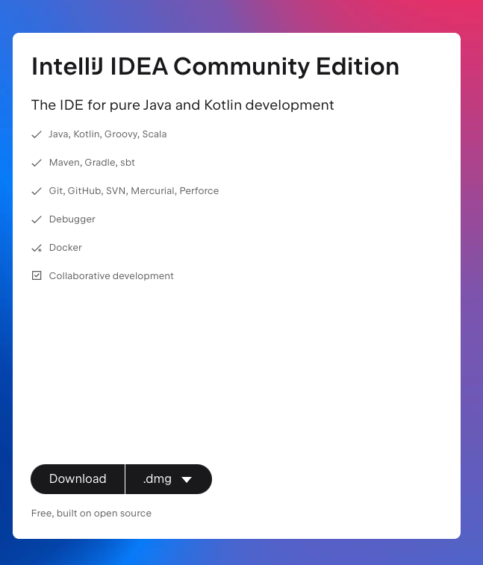
Intellij IDEA
https://www.jetbrains.com/idea/download/?section=mac
Link is as follow:
https://www.jetbrains.com/idea/download/?section=mac

Slide 9
Versions
Java 7 – Declarative programming
Java 8 — Most popular java version
Java 11 - LTS
Java 17 - LTS version before the latest
Java 18, 19 , 20
Java 21 - Latest version [sept 2023]

Slide 10
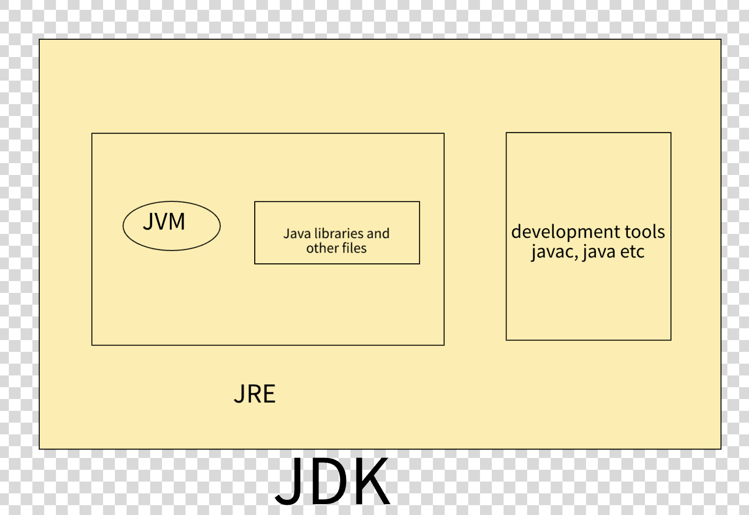
Inside java

Slide 11
Topics to be Covered
Introduction to Programming
Control Statements
Strings
Arrays
Object Oriented Programming(OOPS)

Slide 12
Contd...
Exception Handling
File Handling
Inner Classes
Collections
Java 8 - Lambdas, stream api etc

Slide 13
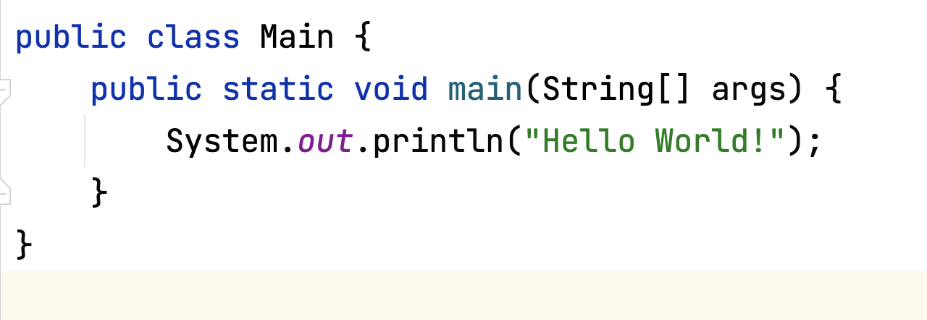
First Java Program

Slide 14
Introduction to Variables
It is the name of reserved area allocated in the memory.
Int x = 10;

Slide 15
Types Of Data type
Primitive
Non Primitive

Slide 16
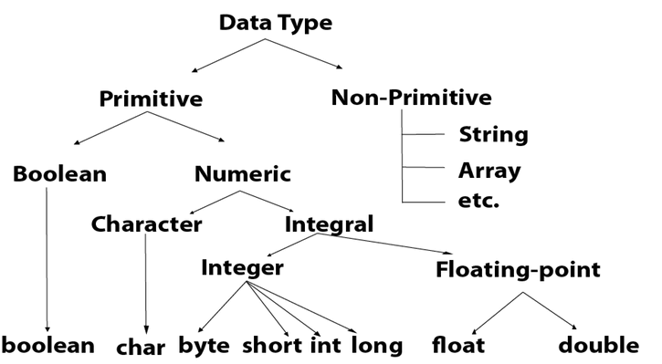
Contd...

Slide 17
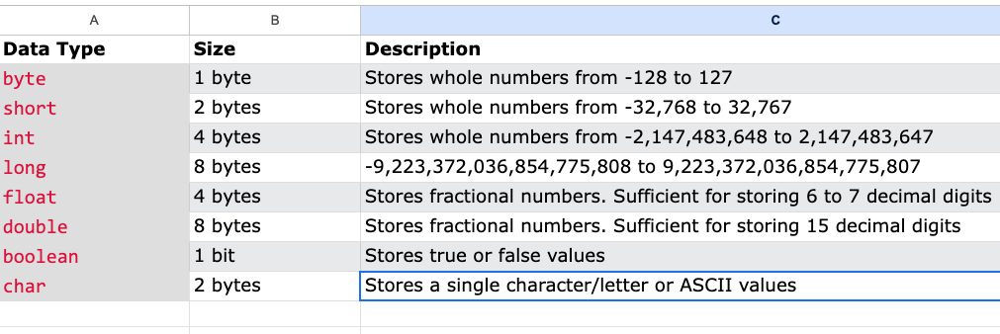
Data types
.

Slide 18
Operators
Operators are used to perform operations on variables and values.
int x = 100 + 50;

Slide 19
Types of Operators
Arithmetic operators
Assignment operators
Comparison operators
Logical operators
Bitwise operators

Slide 20
Arithmetic Operators
- * / % ++ --

Slide 21
Assignment Operators
= += -=

Slide 22
Comparison Operators
==
!=
<
>
>=
<=

Slide 23
Logical Operators
&&, ||, !

Slide 24
Next…
Decision Making statements
If statements
Switch statements
Loop statements
Do while loop
While loop
For loop
For-each loop (Later)

Slide 25
Ternary Operator
Variable = condition? statement1:statement2;
String result = ((number%2 ==0))? "even":"odd";
System.out.println(result);

Slide 26
Next…
Jump Statements
Break
Continue

Slide 27
Problem Statement
Write a Java program to calculate grades based on marks. If the mark is 90 or above, the grade is 'A'. If it's between 80 and 89, the grade is 'B'. For marks between 70 and 79, the grade is 'C'. If the mark is between 60 and 69, the grade is 'D'. Below 60, it's 'F'.
Create a Java application that classifies age into categories. If the age is less than 13, print "Child". If it's between 13 and 19, print "Teenager". For ages between 20 and 59, print "Adult". If the age is 60 or above, print "Senior".
In a theater, the ticket price varies based on the day of the week. Write a Java program that takes the day of the week as input and prints the ticket price. Weekdays have a price of $10, Saturday is $15, and Sunday is $12.

Slide 28
Input in java using Scanner class
Create object of Scanner class
Import java.util.Scanner;
Scanner sc = new Scanner(System.in);

Slide 29
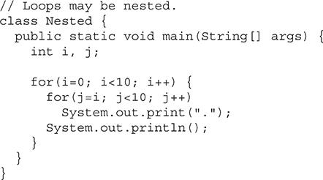
Nested Loops

Slide 30
Classes and Objects
A Class in Java can contain:
Data member
Method
Constructor
Nested Class
Interface

Slide 31
Intro to Classes
Classes are the building blocks of programs built using the object-oriented methodology. Such programs consist of independent self-managing modules and their interactions
An object is an instance of a module, and a class is its definition.
Collection of objects is called class. It is a logical entity.

Slide 32
Objects
Objects in Java
It is a basic unit of Object-Oriented Programming and represents real-life entities. A typical Java program creates many objects, which as you know, interact by invoking methods. An object consists of :
State: It is represented by attributes of an object. It also reflects the properties of an object.
Behavior: It is represented by the methods of an object. It also reflects the response of an object with other objects.
Identity: It gives a unique name to an object and enables one object to interact with other objects.

Slide 33
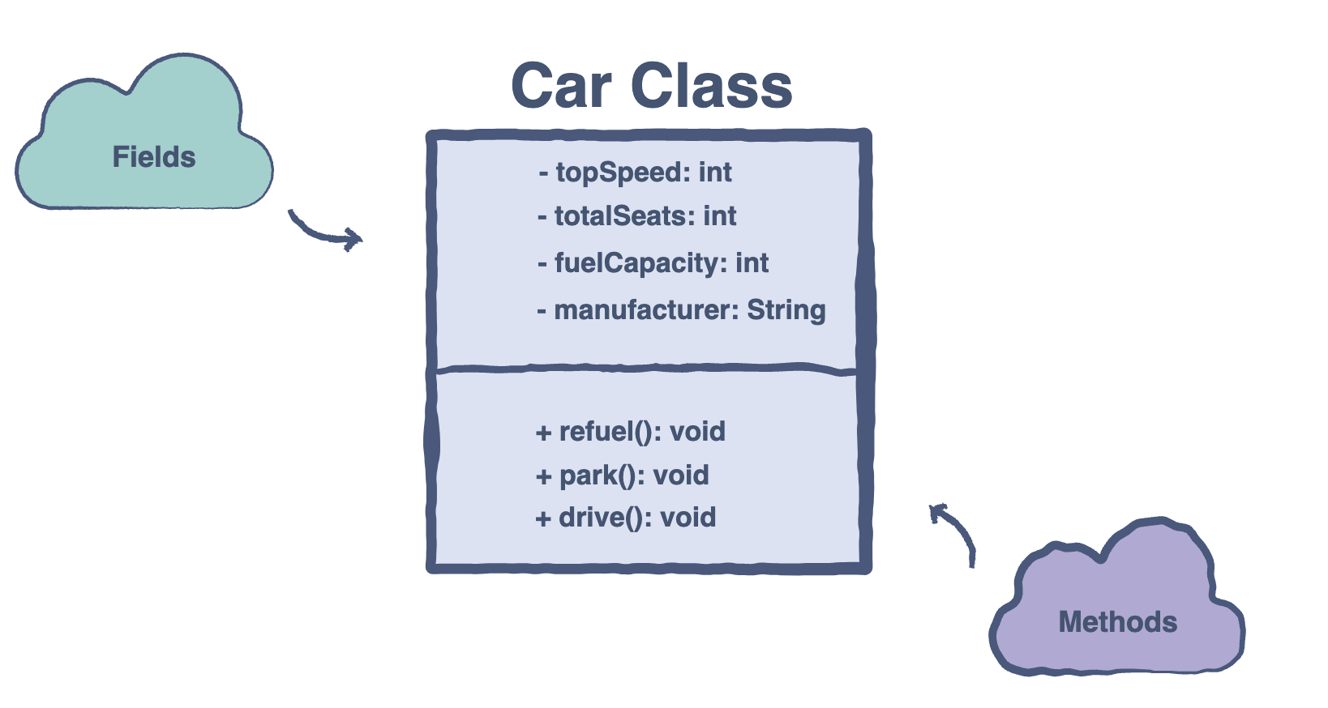

Slide 34
We can see two types of attributes in the Car class above. In general, these two categories are present in all classes.
Fields
These are also known as the member variables of a class. This is because they contain the information relevant to the object of the class. A car object would have a top speed, a certain number of seats, and so many other pieces of data that we could store in variables.
Methods
This category of attributes enables the class object to perform operations using the fields. In the case of the car class, the refuel() function would fill up the fuelCapacity property of the object.

Slide 35
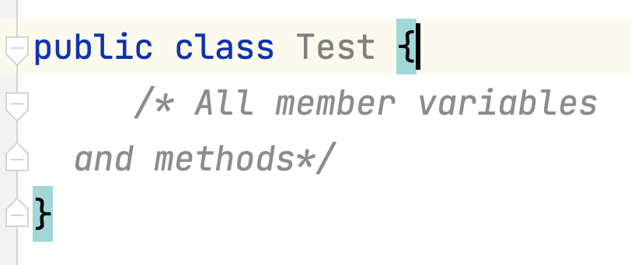
Declaration

Slide 36
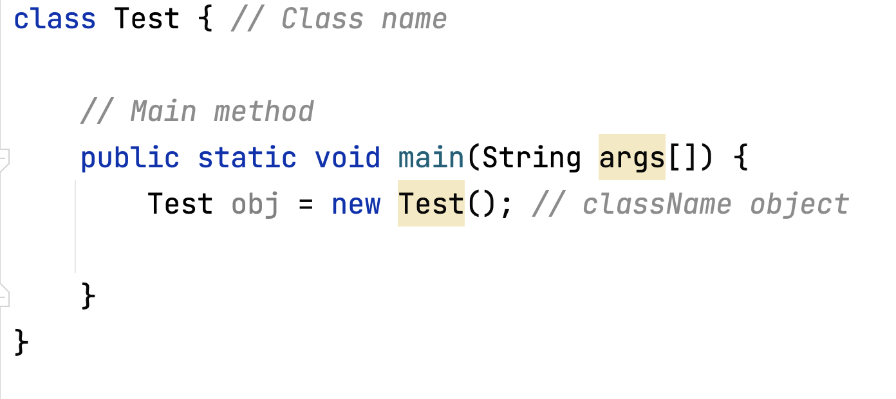
Creating Object
The name of the class, Test, will be used to create an instance of the class in our main program. We can create an object of a class by using the keyword new:

Slide 37
Declare a class
access_modifier class<class_name>
{
data member;
method;
constructor;
nested class;
interface;
}

Slide 38
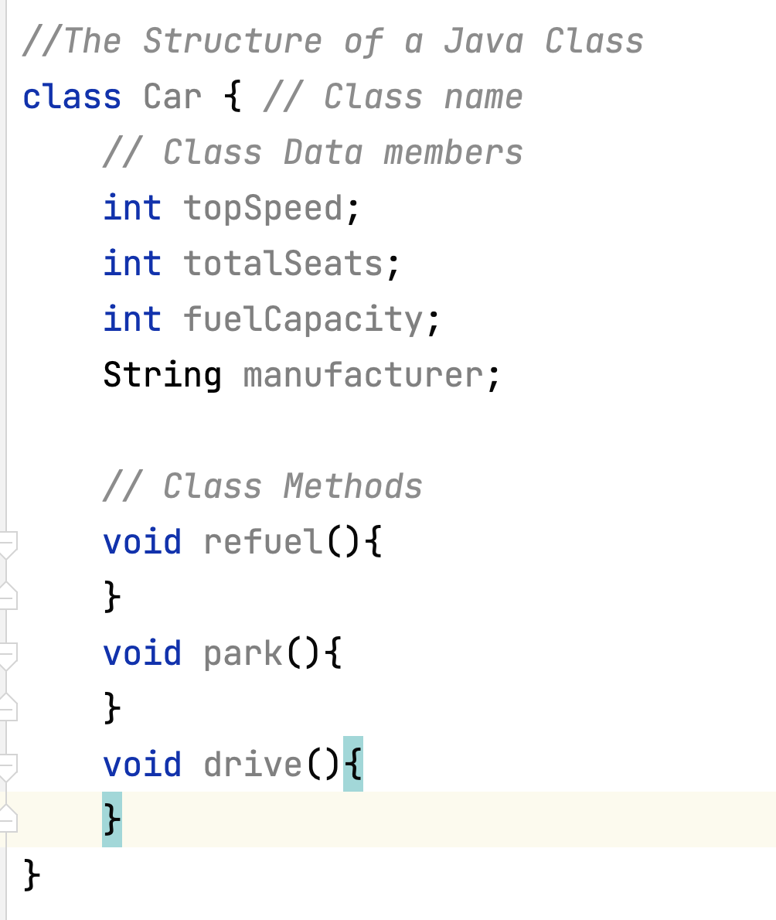

Slide 39
Methods
The method in Java or Methods of Java is a collection of statements that perform some specific task and return the result to the caller. A Java method can perform some specific task without returning anything. Java Methods allow us to reuse the code without retyping the code. In Java, every method must be part of some class that is different from languages like C, C++, and Python.

Slide 40
Continue…
1. A method is like a function i.e. used to expose the behavior of an object. 2. It is a set of codes that perform a particular task.

Slide 41
Constructor
As the name suggests, the constructor is used to construct the object of a class. It is a special method that outlines the steps that are performed when an instance of a class is created in the program.
A constructor’s name must be exactly the same as the name of its class.
The constructor is a special method because it does not have a return type. We do not even need to write void as the return type. It is a good practice to declare/define it as the first member method.

Slide 42
Types of constructor
Default or non parameterized
Parameterized

Slide 43
Default Constructor
The default constructor is the most basic form of a constructor. In a default constructor, we define the default values for the data members of the class. Hence, the constructor creates an object in which the data members are initialized to their default values.
If you don’t define any constructor, the Java compiler will insert a default constructor for you. Thus, once the class is compiled it will always at least have a no-argument constructor.
If you don’t define any constructor, the Java compiler will insert a default constructor for you. Thus, once the class is compiled it will always at least have a no-argument constructor.

Slide 44
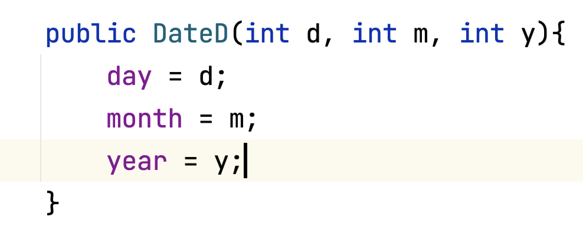
Parameterized constructor
In a parameterized constructor, we pass arguments to the constructor and set them as the values of our data members.

Slide 45
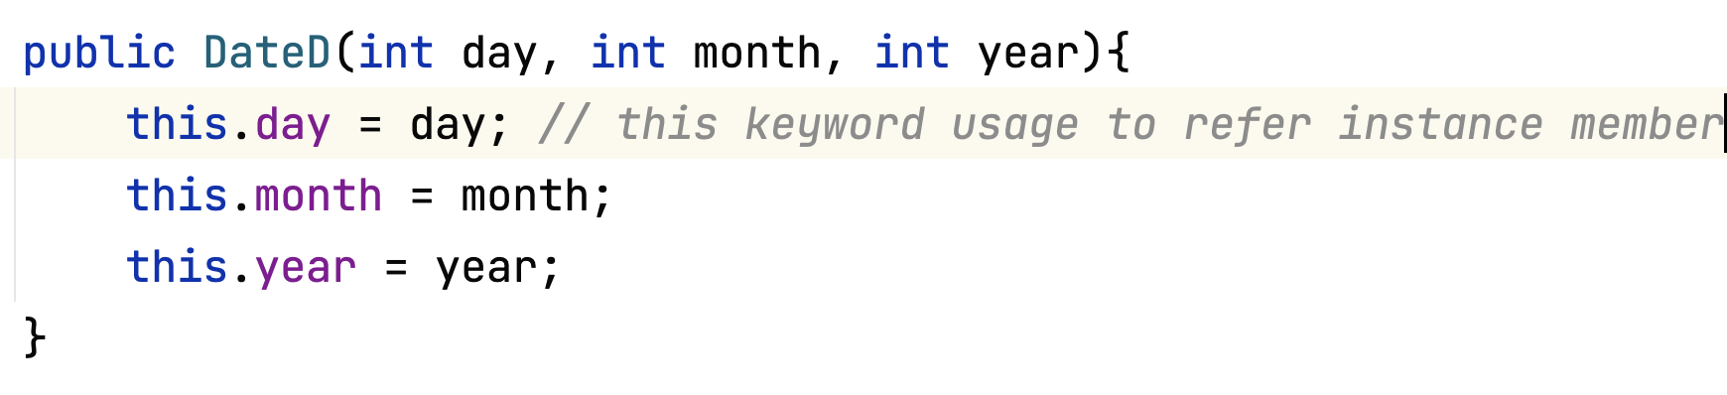
This Keyword
The this reference variable exists for every class. It refers to the class object itself. We use this when we have an argument which has the same name as a data member. this.memberName specifies that we are accessing the memberName variable of the particular class.

Slide 46
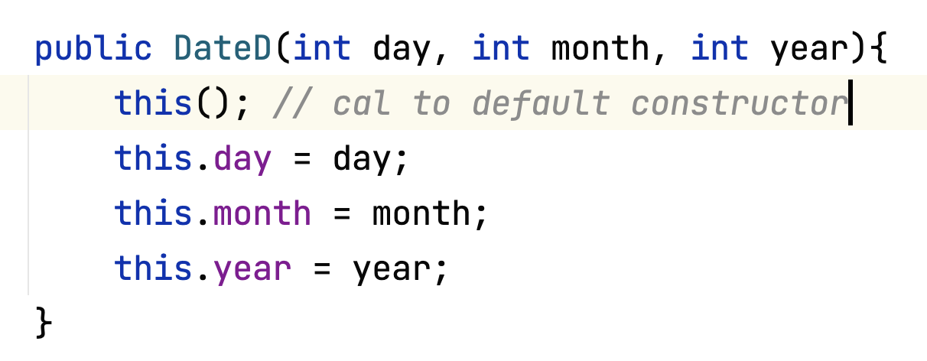
Call Constructor from a constructor
In Java, we can call a constructor from a constructor. When you call a constructor from another constructor, you use the this keyword to refer to the constructor.

Slide 47
Memory management
Heap vs stack
The JVM divides the memory into two parts: stack memory and heap memory. From the perspective of Java, both are important memory areas but both are used for different purposes. The major difference between Stack memory and heap memory is that the stack is used to store the order of method execution and local variables while the heap memory stores the objects and it uses dynamic memory allocation and deallocation

Slide 48
Memory management
Stack - LIFO , FIFO (Queue)
It stores the variables, references to objects, and partial results. Memory allocated to stack lives until the function returns. If there is no space for creating the new objects, it throws the java.lang.StackOverFlowError

Slide 49
Heap
It is created when the JVM starts up and used by the application as long as the application runs. It stores objects and JRE classes. Whenever we create objects it occupies space in the heap memory while the reference of that object creates in the stack. It does not follow any order like the stack. It dynamically handles the memory blocks. It means, we need not to handle the memory manually. For managing the memory automatically, Java provides the garbage collector that deletes the objects which are no longer being used. Memory allocated to heap lives until any one event, either program terminated or memory free does not occur. The elements are globally accessible in the application. It is a common memory space shared with all the threads. If the heap space is full, it throws the java.lang.OutOfMemoryError

Slide 50
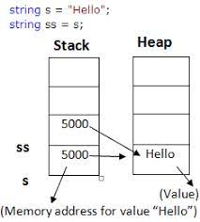
Stack and heap
.

Slide 51
Variables
A variable is a container which holds the value while the Java program is executed. A variable is assigned with a data type.
3 types of variables
Local
Instance
static

Slide 52
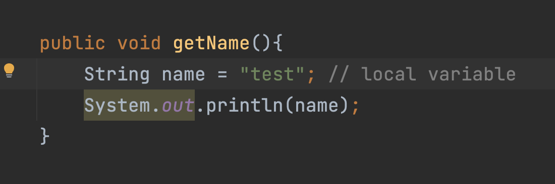
Local
A variable declared inside the body of the method is called local variable. You can use this variable only within that method and the other methods in the class aren't even aware that the variable exists.

Slide 53
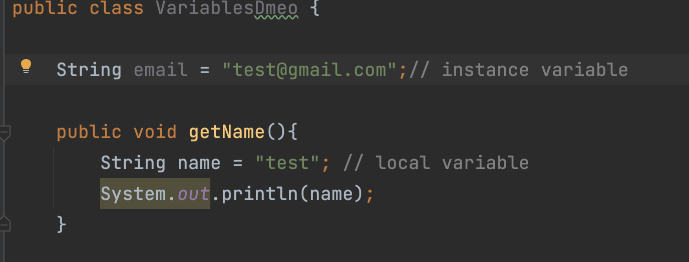
Instance variable
A variable declared inside the class but outside the body of the method, is called an instance variable. It is not declared as static.
It is called an instance variable because its value is instance-specific and is not shared among instances.

Slide 54
Static keyword
The static keyword in Java is used for memory management mainly. We can apply static keyword with variables, methods, blocks and nested classes. The static keyword belongs to the class than an instance of the class.

Slide 55
Static keyword
The static can be:
Variable (also known as a class variable)
Method (also known as a class method)
Block
Nested class

Slide 56
Static variable
The static variable can be used to refer to the common property of all objects (which is not unique for each object), for example, the company name of employees, college name of students, etc.
The static variable gets memory only once in the class area at the time of class loading

Slide 57
Static Method
If you apply static keyword with any method, it is known as static method.
A static method belongs to the class rather than the object of a class.
A static method can be invoked without the need for creating an instance of a class.
A static method can access static data member and can change the value of it.

Slide 58
More on static…
Restrictions for the static method
There are two main restrictions for the static method. They are:
The static method can not use non static data member or call non-static method directly.
this and super cannot be used in static context.

Slide 59
Arrays
Java array is an object which contains elements of a similar data type. Additionally, The elements of an array are stored in a contiguous memory location. It is a data structure where we store similar elements. We can store only a fixed set of elements in a Java array
Array in Java is index-based, the first element of the array is stored at the 0th index, 2nd element is stored on 1st index and so on.

Slide 60
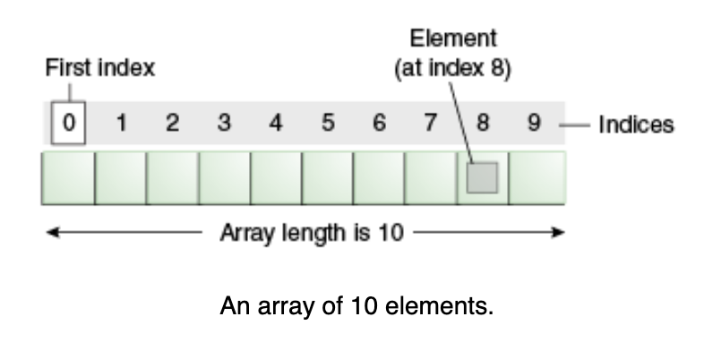
.
.

Slide 61
Declaring Arrays
Like any other variable, an array must be declared, and its type specified. The type for an array of int values is int[]. You can think of the empty brackets as shorthand for the word “array”:
int[] myNumbers;

Slide 62
Initializing arrays
int[] myNumbers = {10, 15, 20, 25, 30};

Slide 63
Strings
In Java, string is basically an object that represents sequence of char values
Create String object
Literal
By Using new keyword
String Literal does not create new keyword
String s1 = “test”
String s2 = “test”

Slide 64
Immutable Strings
Compare two strings .equals and ==
Concatenation
Methods in String class
toString()
StringBuilder
StringBuffer
String vs StringBuilder vs StringBuffer https://www.freecodecamp.org/news/garbage-collection-in-java-what-is-gc-and-how-it-works-in-the-jvm/

Slide 65
Access Modifiers
Public
Private
Protected
default

Slide 66
Private
A private member cannot be accessed directly from outside the class. The aim is to keep it hidden from the users and other classes. It is a popular practice to keep the data members private since we do not want anyone manipulating our data directly. We can make members private using the keyword private.

Slide 67
Public
This tag indicates that the members can be directly accessed by anything which is in the same scope as the class object.
Member functions are usually public as they provide the interface through which the application can communicate with our private members.
Public members can be declared using the keyword public.

Slide 68
Protected
The protected category is unique. The access level to the protected members lies somewhere between private and public. The primary use of the protected tag can be found when using inheritance, which is the process of creating classes out of other classes.
The protected data members can be accessed inside a Java package. However, outside the package, they can only be referred to through an inherited class.

Slide 69
Default
If we do not mention any access modifier, then it is considered to be default access. The default access is similar to the protected. It also has package-level access, but it also applies to inherited classes as well, unlike protected. So, you can say that its access is more limited.

Slide 70
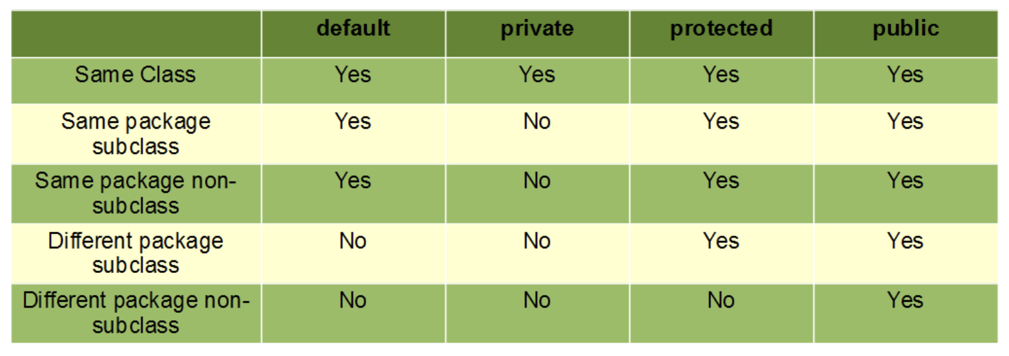
More..

Slide 71
OOPs
Inheritance
Polymorphism
Abstraction
Encapsulation

Slide 72
Inheritance
Inheritance provides a way to create a new class from an existing class. The new class is a specialized version of the existing class such that it inherits all the non-private fields (variables) and methods of the existing class. The existing class is used as a starting point or as a base to create the new class.

Slide 73
Is a relationship..
The IS A relationship
After reading the above definition, the next question that comes to your mind is What is the use case of inheritance? Well, the answer is that wherever we come across an IS A relationship between objects, we can use inheritance.

Slide 74
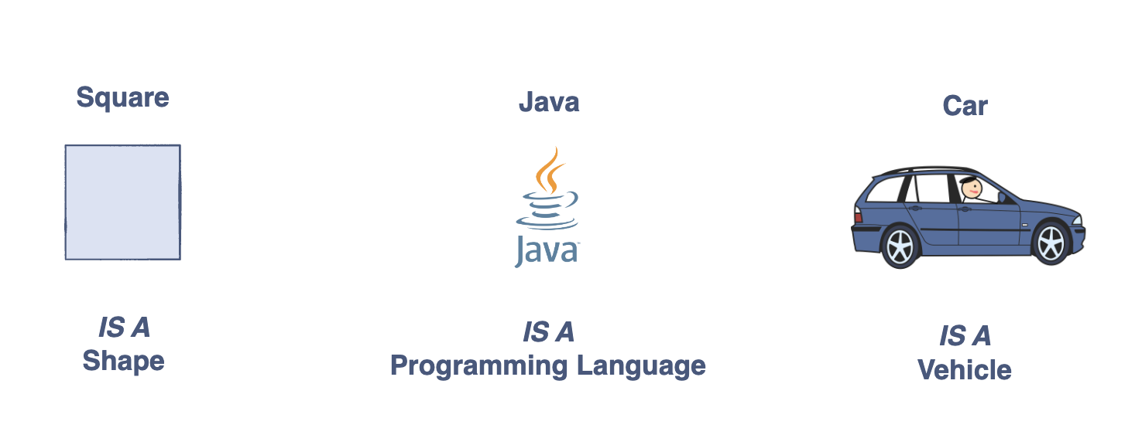
Continue…

Slide 75
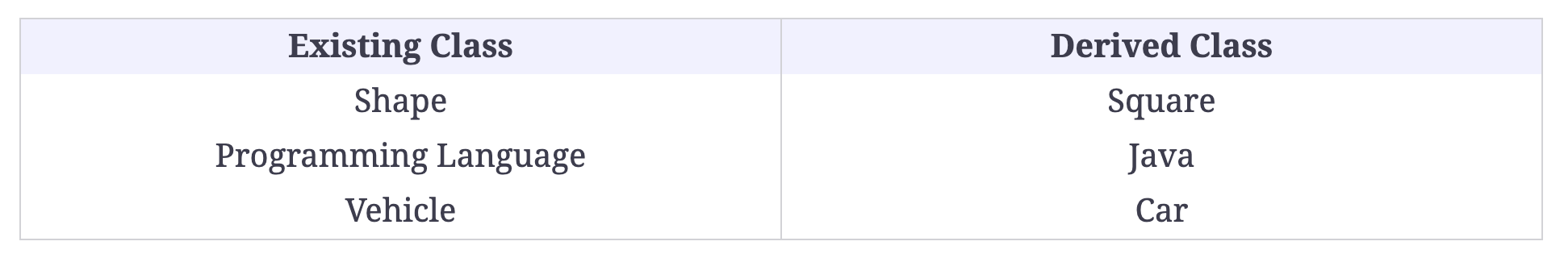
Example
So from the above descriptions regarding inheritance, we can conclude that we can build new classes by depending on the existing classes. We can build some new classes.

Slide 76
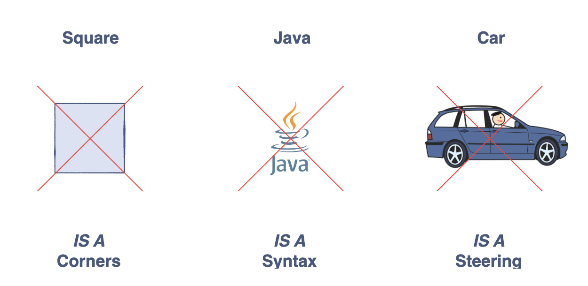
``
Let’s find out where an IS A relationship doesn’t exist.

Slide 77
Terminologies
SuperClass (Parent Class or Base Class): This class allows the re-use of its non-private members in another class.
SubClass (Child Class or Derived Class): This class is the one that inherits from the superclass.
Note: A child class has all non-private characteristics of the parent class.

Slide 78
continue..
What does a child class have?
An object of the child class can use:
All non-private members defined in the child class.
All non-private members defined in the parent class.
Note: Some classes cannot be inherited. Such classes are defined with the keyword, final. An example of such a class is the built-in Integer class - this class cannot have derived classes.

Slide 79
So How we start inheritance?
Use “extends” keyword
SubClass extends SuperClass{
//contents of SubClass
}

Slide 80
Types of Inheritance
Single
Multi-level
Hierarchical
Multiple
Hybrid

Slide 81
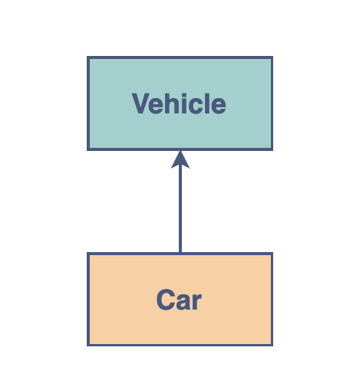
Single
In single inheritance, there is only a single class extending from another class. We can take the example of the Vehicle class (Super class) and the Car class (Sub class).

Slide 82
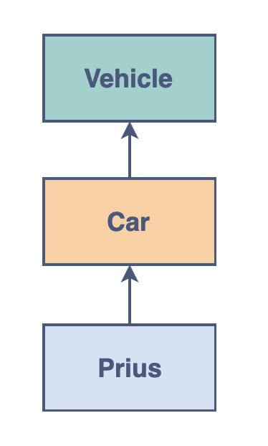
Multi level Inheritance
When a class is derived from such a class which itself is derived from another class, this type of inheritance is called Multilevel Inheritance. Classes can be extended to any further levels as per the requirement of the model.

Slide 83
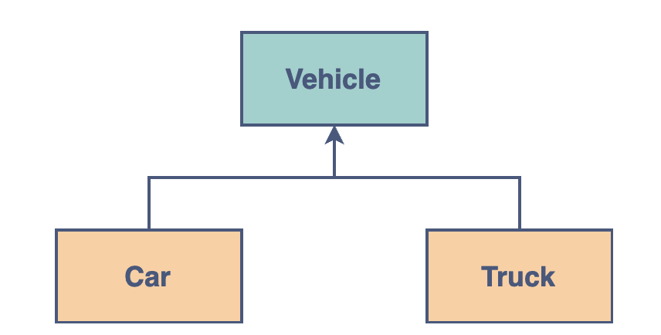
Hierarchical Inheritance#
When more than one classes inherit from the same class, it is referred to as hierarchical inheritance. In hierarchical inheritance, more than one classes extend, as per the requirement of the design, from the same base class. The common attributes of these child classes are implemented inside the base class.

Slide 84
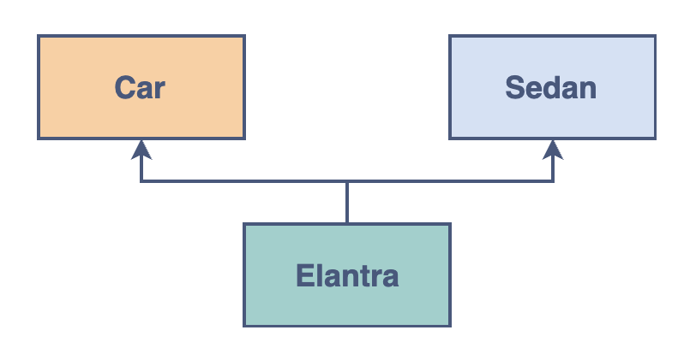
Multiple Inheritance
When a class[basically interface in java ] is derived from more than one base class, i.e. when a class has more than one immediate parent classes, this type of inheritance is called Multiple Inheritance Note: Java class does not support multiple inheritance .

Slide 85
Hybrid Inheritance
A type of inheritance which is a combination of Multiple and Multi-level inheritance is called hybrid inheritance.
A combustion engine is an engine
An electric motors engine is an engine
A Hybrid engine combines both combustion engine and electric motors.

Slide 86
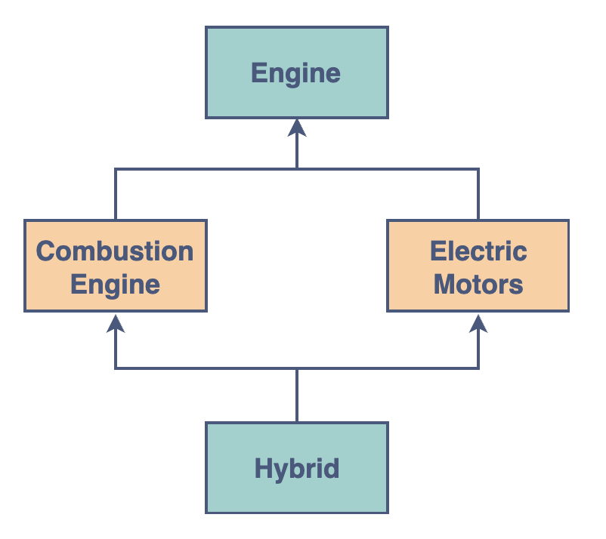
Hybrid Inheritance
.

Slide 87
Super
Use cases of the super keyword
Accessing parent class fields
Calling a parent class method
Using with constructors

Slide 88
Encapsulation
Encapsulation in Java is a process of wrapping code and data together into a single unit
We can create a fully encapsulated class in Java by making all the data members of the class private.
By providing only a setter or getter method, you can make the class read-only or write-only. In other words, you can skip the getter or setter methods.
It is a way to achieve data hiding in Java because other class will not be able to access the data through the private data members.

Slide 89
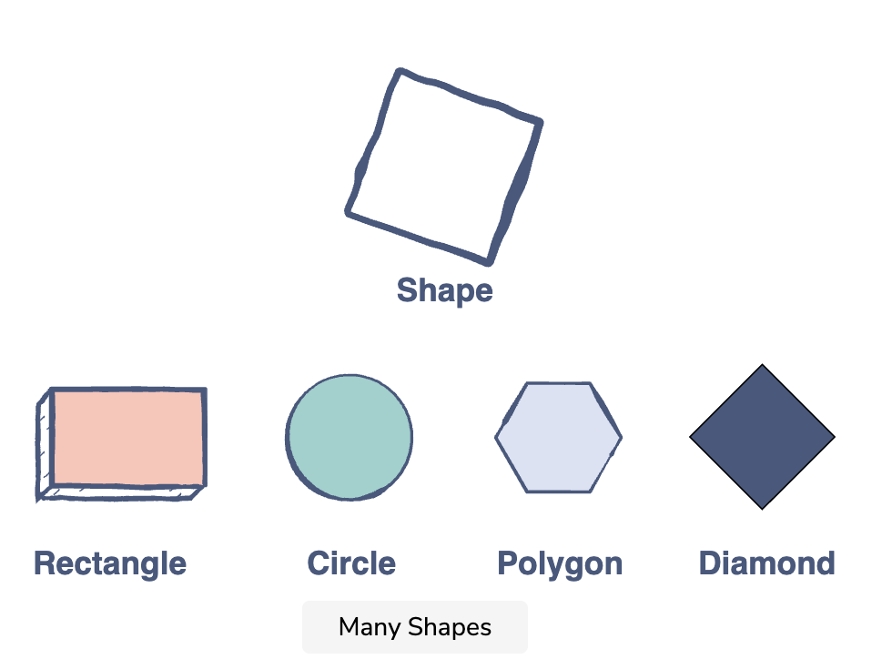
Polymorphism
The word Polymorphism is a combination of two Greek words, Poly means many and Morph means forms.

Slide 90
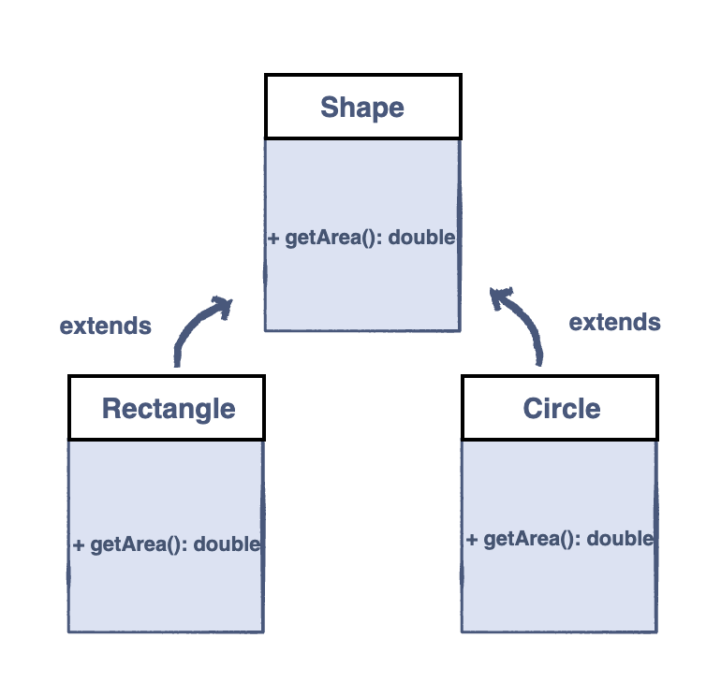
continue..
.

Slide 91
Method Overriding
Method overriding is the process of redefining a parent class’s method in a subclass.
In other words, if a subclass provides the specific implementation of a method that has been declared by one of its parent classes, it is known as method overriding.

Slide 92
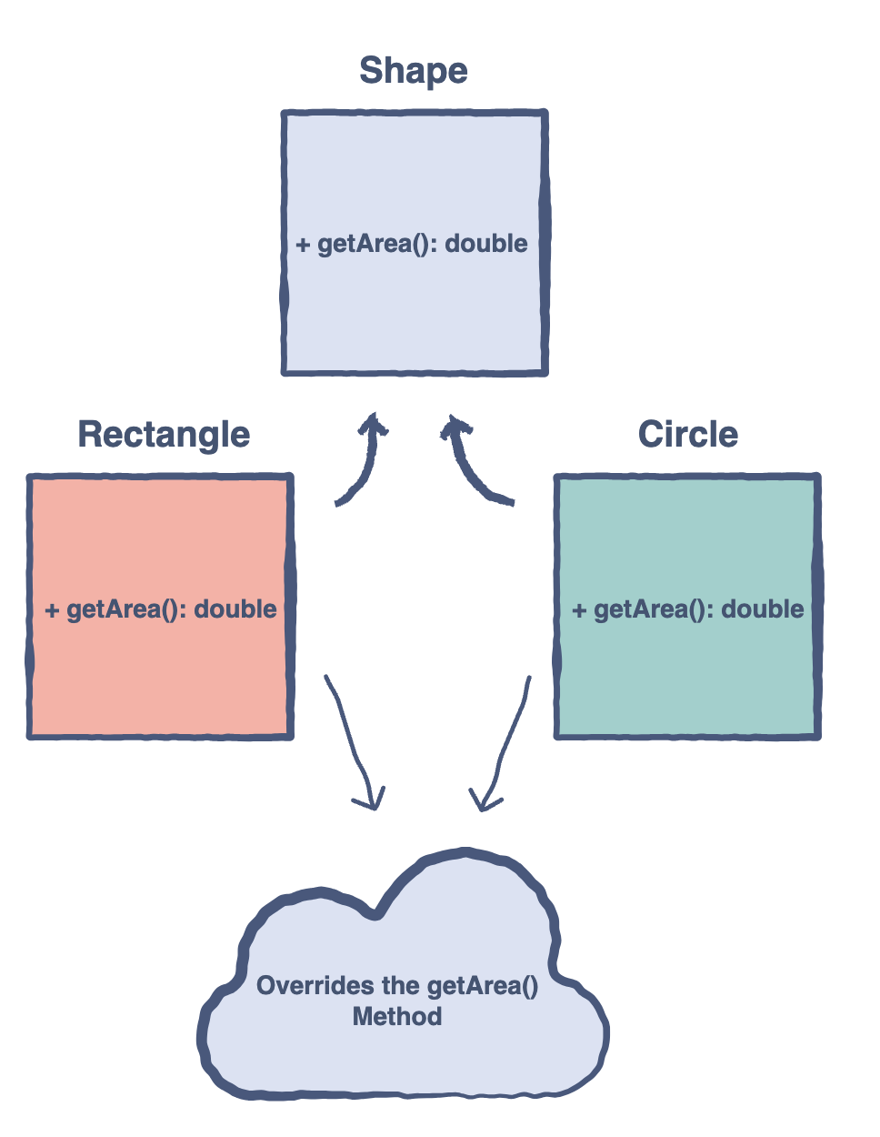
.
For example, the Rectangle and Circle
classes can override the getArea()
method from the Shape class.
Overriding is done so that a child class can give
its own implementation to a method which is
already provided by the parent class.

Slide 93
Advantages of the method overriding
Method overriding is very useful in OOP. Some of its advantages are stated below:
The derived classes can give their own specific implementations to inherited methods without modifying the parent class methods.
For any method, a child class can use the implementation in the parent class or make its own implementation.

Slide 94
Key features of the method overriding
Here are some key features of method overriding:
Method overriding needs inheritance and there should be at least one derived class.
Derived class(es) must have the same declaration, i.e., access modifier, name, same parameters and same return type as the method as of the base class.
The method in the derived class(es) must have different implementations from each other.
The method in the base class must be overridden in the derived class.
Base class/method must not be declared as a final class.

Slide 95
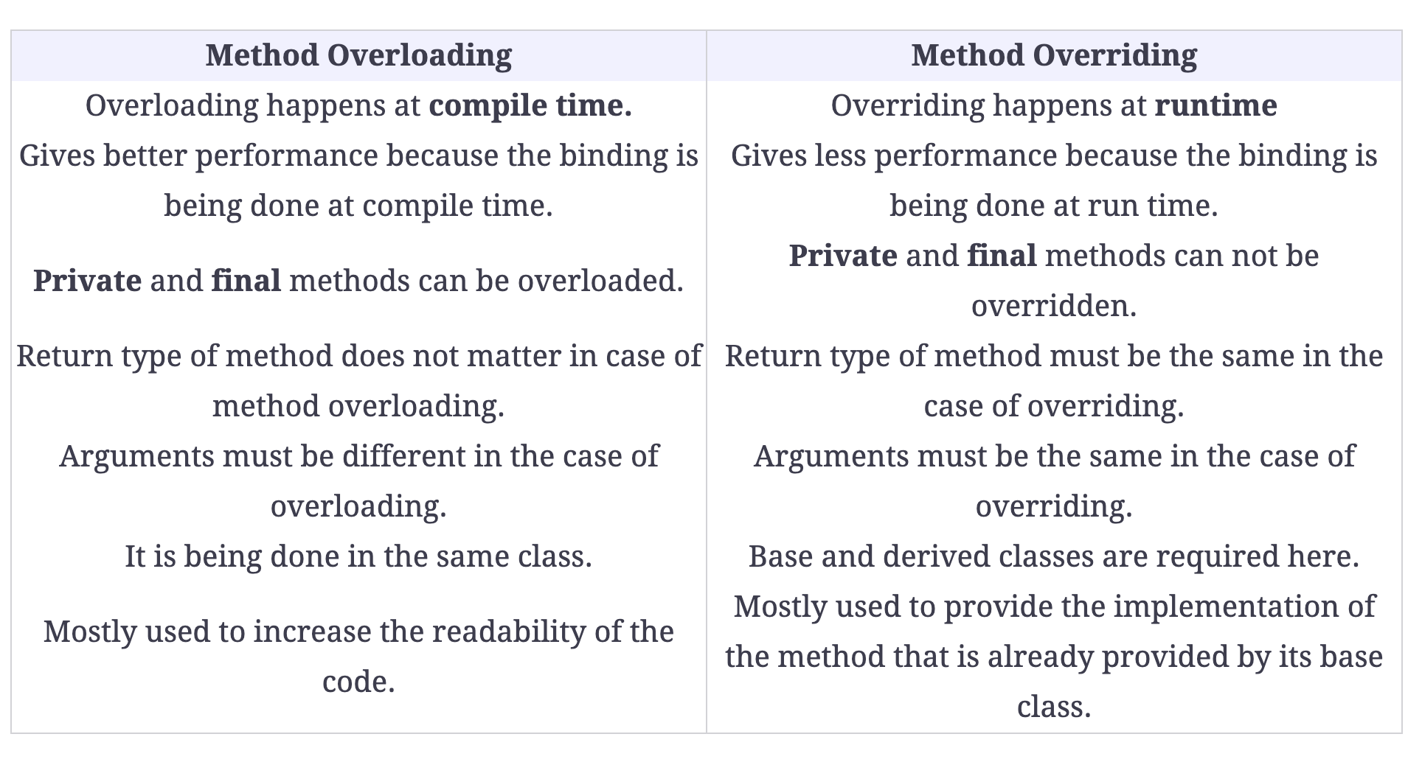
.

Slide 96
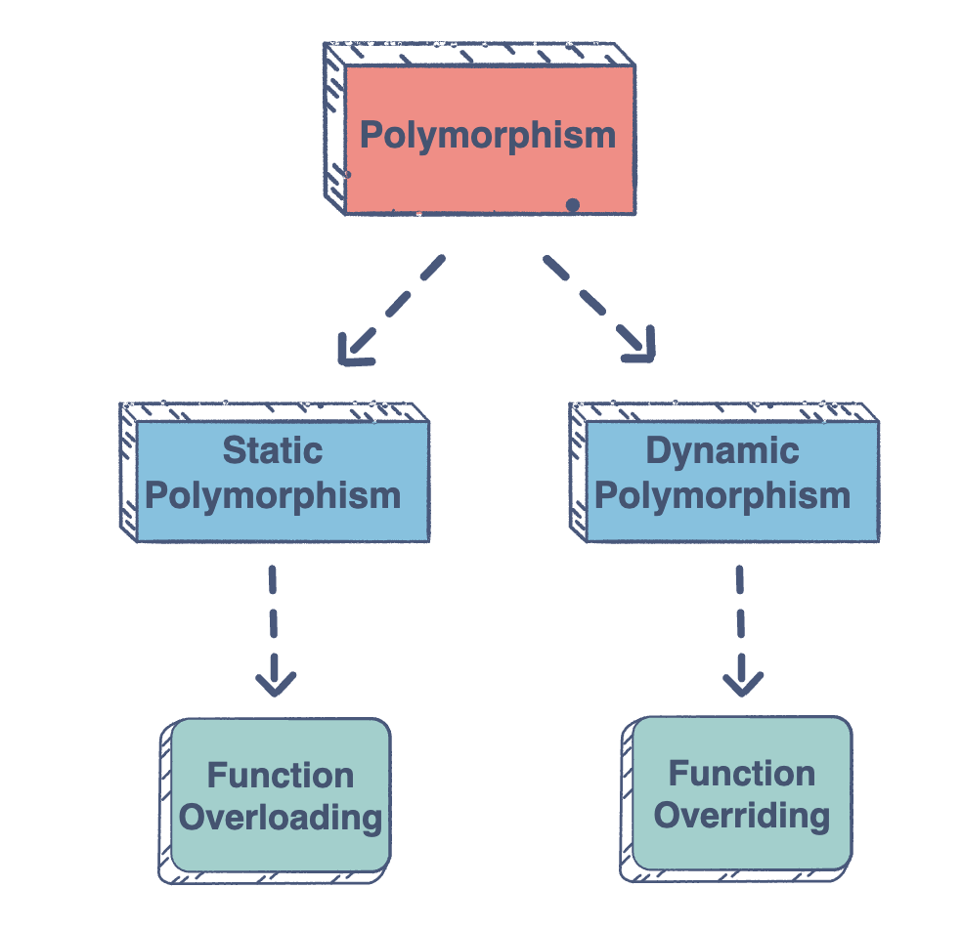
.
.

Slide 97
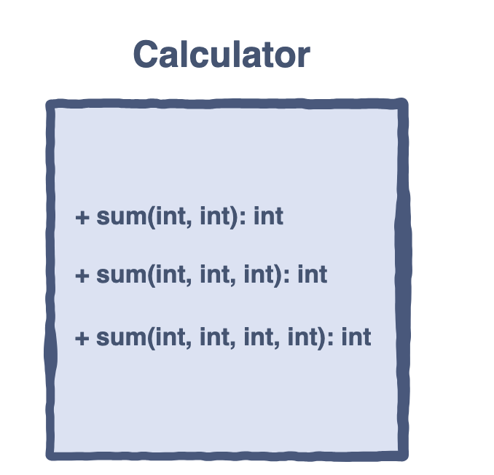
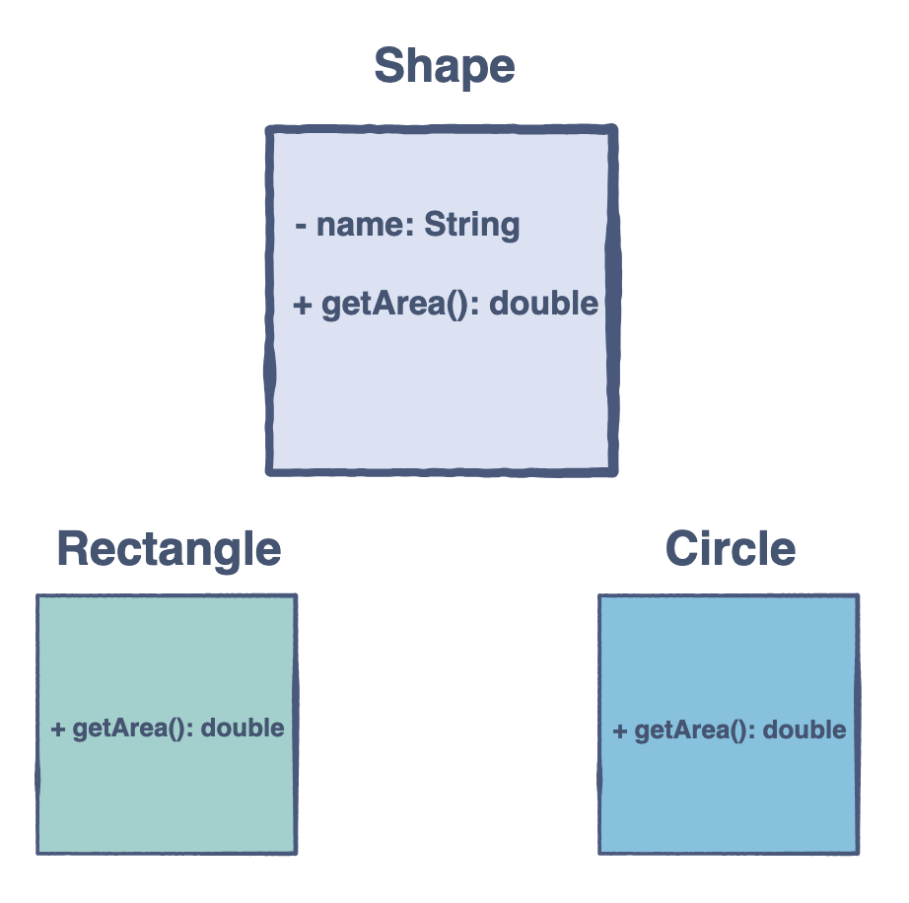

Slide 98
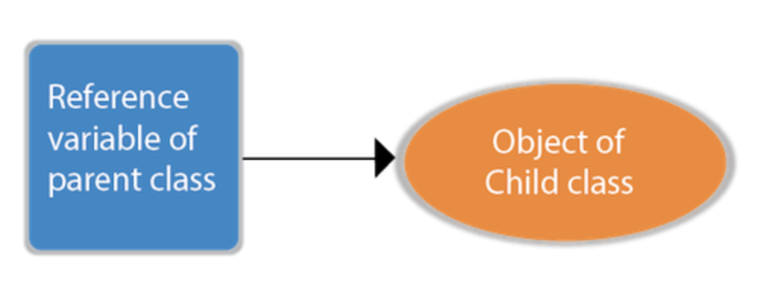
Upcasting
When an object of a Child class is referred to by a reference variable of the Parent class, this is referred to as upcasting
Upcasting gives us the flexibility to access the parent class members but it is not possible to access all the child class members using this feature

Slide 99
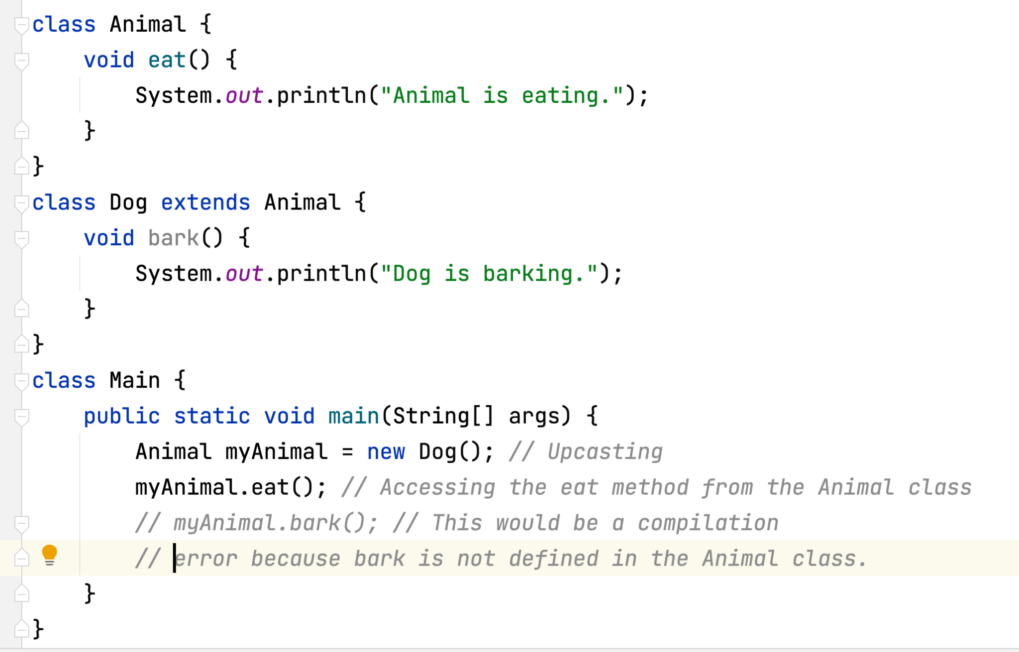

Slide 100
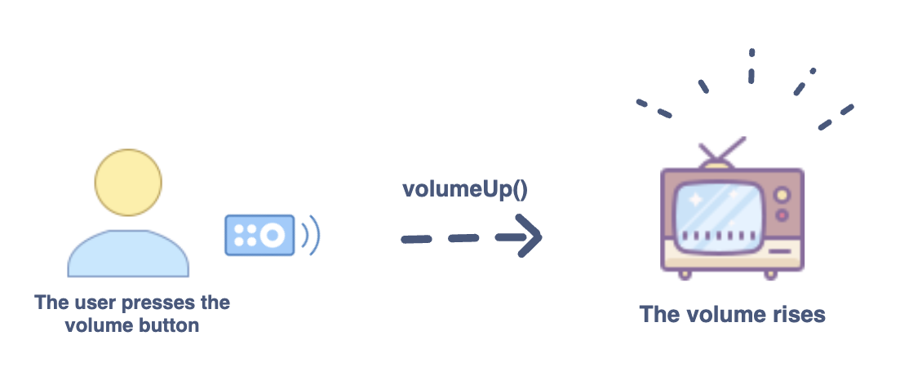
Abstraction
Abstraction in Object-Oriented Programming refers to showing only the essential features of an object to the user and hiding the inner details to reduce complexity. It can be put this way that the user only has to know

Slide 101
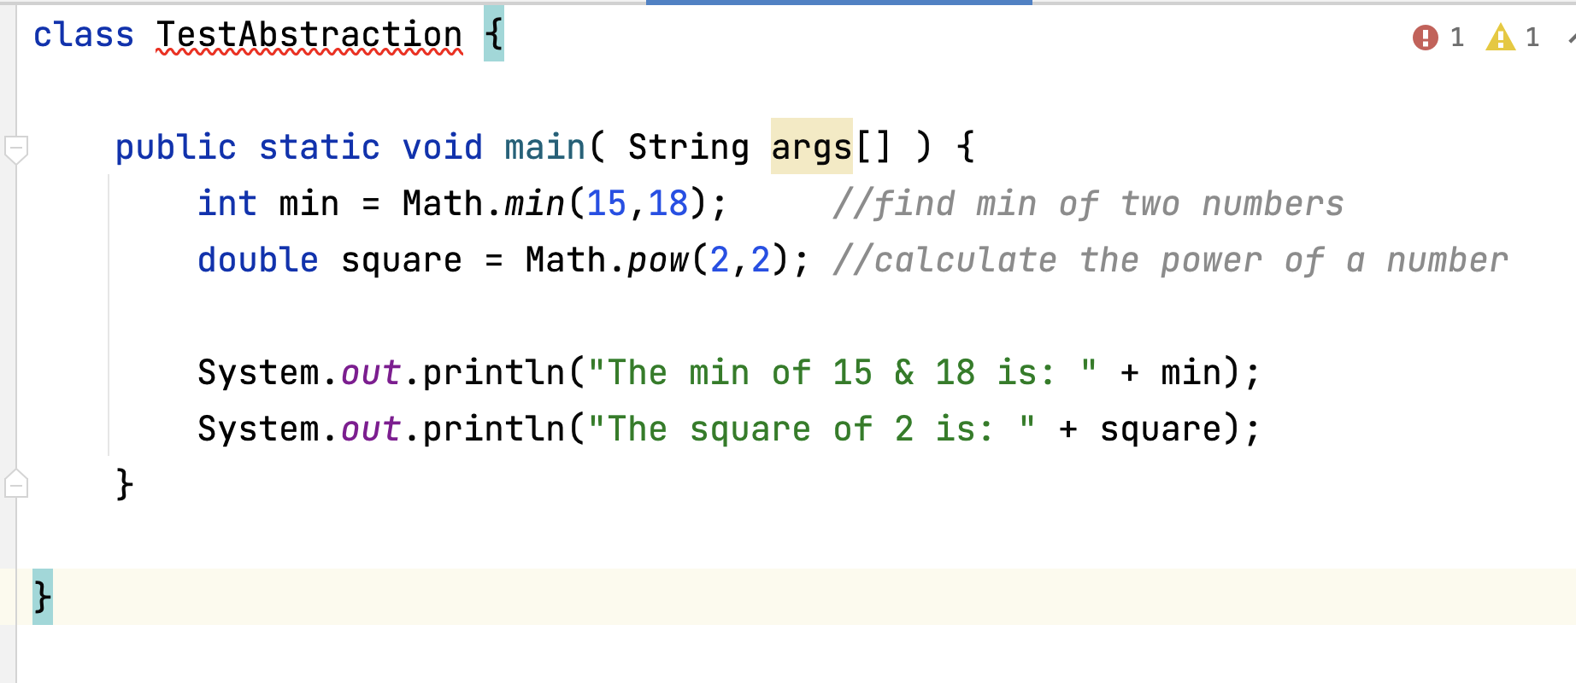
In Java, one can very easily see abstraction in action. Let’s take an example of Java Math class. There are a lot of in-built methods in this class that can be used by the programmer to get facilitated. Let’s use a few methods in our code to access the in-built functionality:

Slide 102
How to achieve abstraction
In Java, we use the following components to achieve abstraction:
Abstract Classes
Interfaces

Slide 103
Abstract methods
A method with the keyword abstract in its declaration is known as an abstract method.
public abstract void methodName(parameter(s));
Rules to be followed
In contrast to a concrete/normal Java method an abstract method does not have a body/definition i.e. it only has a declaration or method signature inside an abstract class or an interface.
An abstract method can be declared inside an abstract class or an interface only.
In other words, it can be said that to contain any abstract method in its implementation a class has to be declared as an abstract class because non-abstract classes cannot have abstract methods.
An abstract method cannot be declared private as it has to be implemented in some other class.

Slide 104
continue..
An abstract method’s declaration has:
An access identifier
The keyword abstract
A return type
A name of the method
The parameter(s) to be passed
A semicolon(;) to end the declaration

Slide 105
Abstract class
Rules to be followed
An abstract class cannot be instantiated i.e. one cannot create an object of an abstract class.
An abstract class can have the declaration of abstract method(s) (as an abstract method’s body cannot be implemented in an abstract class) but it is not compulsory to have any.
Non-abstract/normal methods can be implemented in an abstract class.
To use an abstract class it needs to be inherited from.
The class which inherits from the abstract class must implement all the abstract methods declared in the parent abstract class.
An abstract class can have everything else as same as a normal Java class has i.e. constructor, static variables and methods.

Slide 106
Example
Consider modeling an Animal kingdom using Java having:
A base abstract class named Animal
A child class named Dog
A child class named Cat
A child class named Sheep

Slide 107
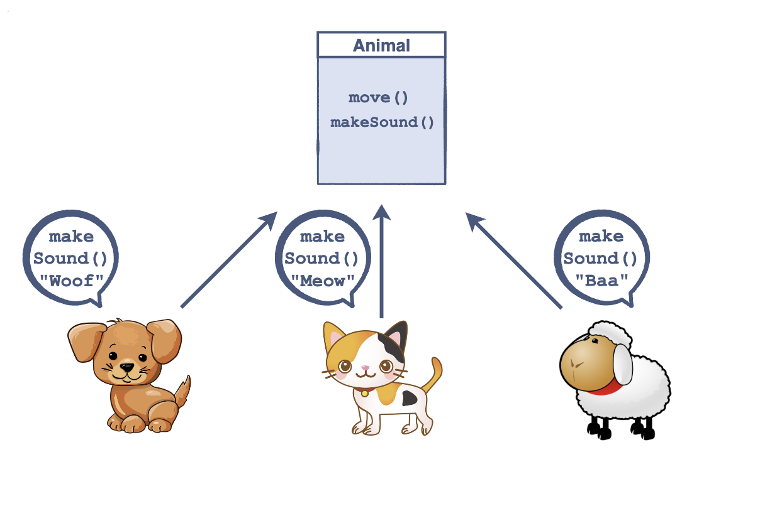
continue..

Slide 108
Interface
An interface is just like a class and specifies the behavior that a class must implement.
An interface can be used to achieve 100% abstraction as it contains the method signatures/abstract methods(what to be done) and no implementation details (how to be done) of these methods. In this way, interfaces satisfy the definition of abstraction. The implementation techniques of the methods declared in an interface are totally up to to the classes implementing that interface.
An interface can be thought of as a contract that a class has to fulfill while implementing an interface. According to this contract, the class that implements an interface has to @Override all the abstract methods declared in that very interface.

Slide 109
Rules for interface
An interface can have:
abstract method(s)
default method(s) - Java 8 and above
static method(s)
private method(s) - Java 9 and above
private static method(s)
public static final variable(s)

Slide 110
continue..
All the methods declared or implemented in an interface are by default public and all the variables are by default public static final.
Just like an abstract class, an interface cannot be instantiated.
To use an interface, a class must implement all of the abstract method(s) declared in it.
An interface cannot have constructor(s) in it.
A class cannot extend from more than one class, but it can implement any number of interfaces.
An interface can extend from another interface.
An interface cannot be declared private or protected.

Slide 111
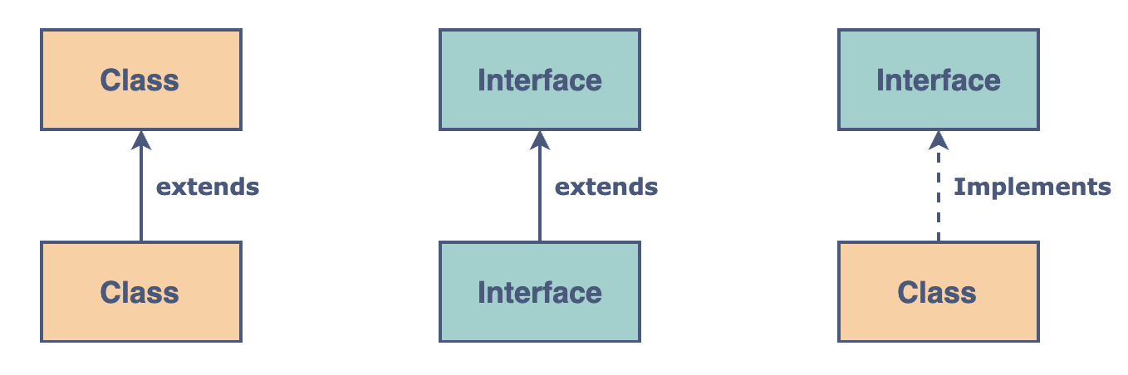

Slide 112
Inner Classes
In Java, it is also possible to nest classes (a class within a class). The purpose of nested classes is to group classes that belong together, which makes your code more readable and maintainable.
To access the inner class, create an object of the outer class, and then create an object of the inner class:

Slide 113
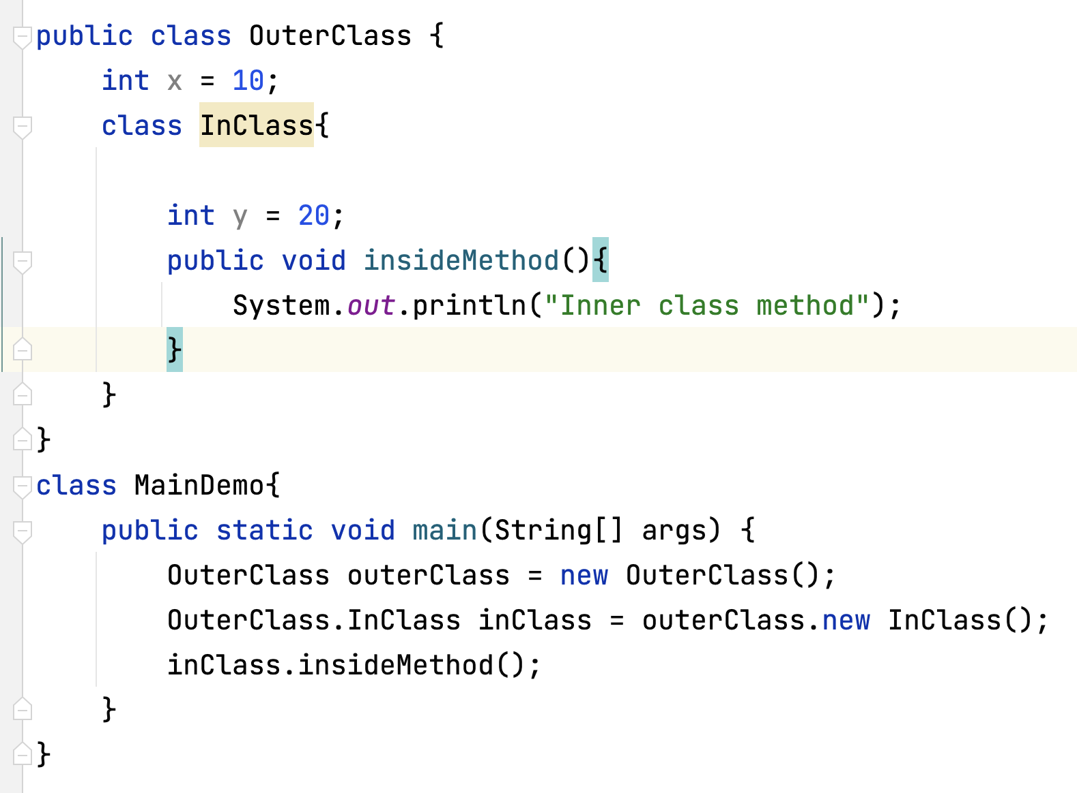
.
.

Slide 114
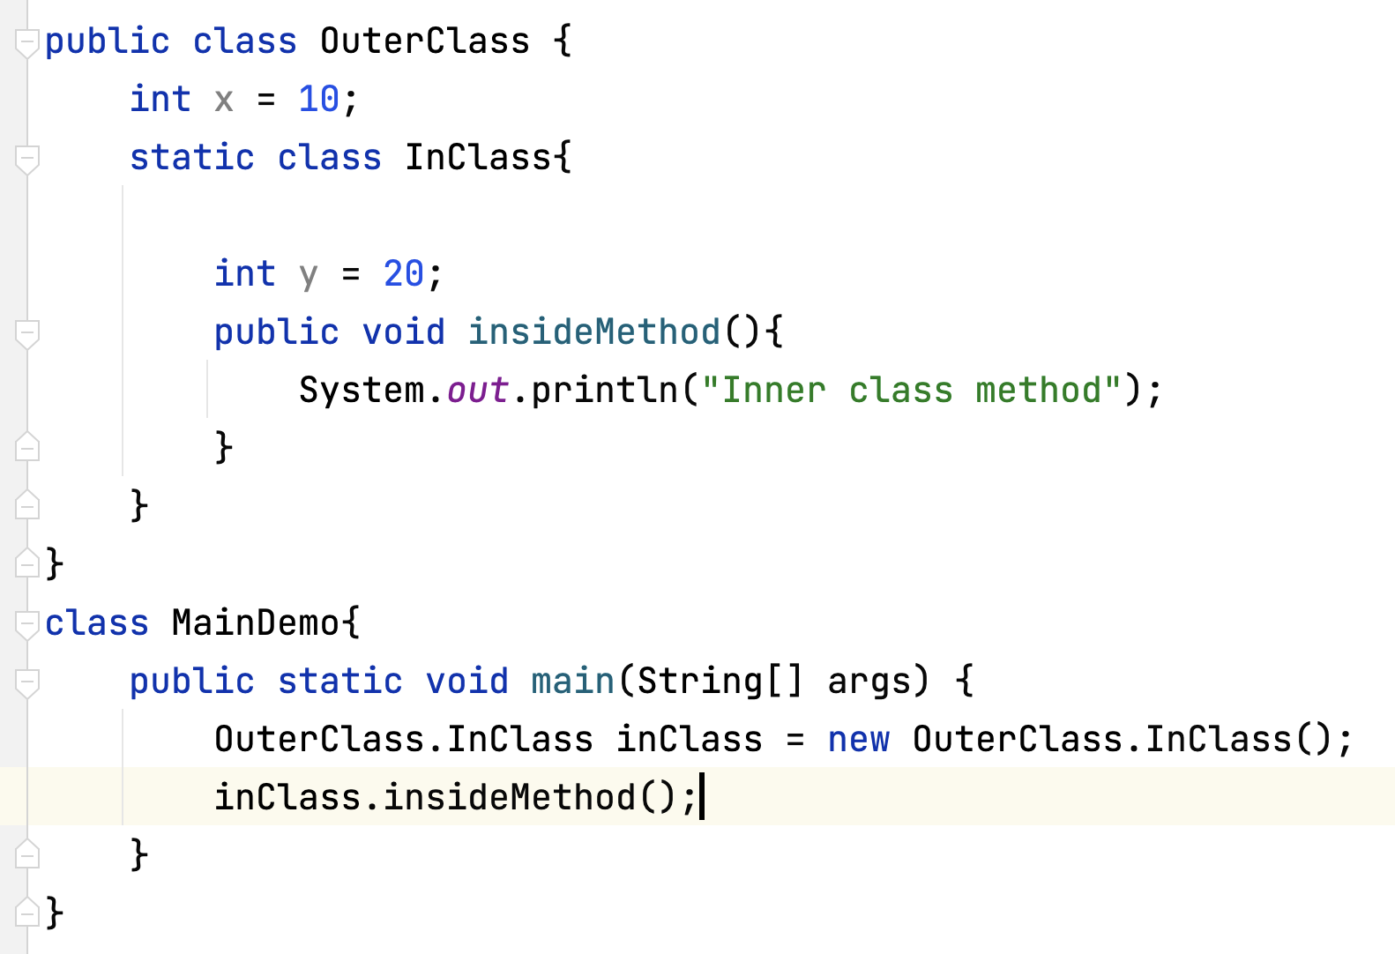
Static Inner Class
An inner class can also be static, which means that you can access it without creating an object of the outer class:

Slide 115
Anonymous Inner Class
Java anonymous inner class is an inner class without a name and for which only a single object is created. An anonymous inner class can be useful when making an instance of an object with certain "extras" such as overloading methods of a class or interface, without having to actually subclass a class.
In simple words, a class that has no name is known as an anonymous inner class in Java. It should be used if you have to override a method of class or interface. Java Anonymous inner class can be created in two ways:
Class (may be abstract or concrete).
Interface

Slide 116
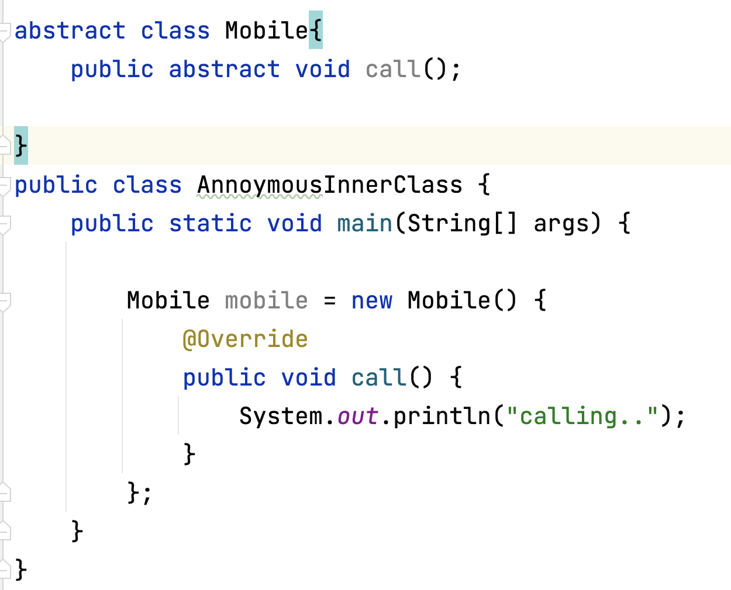
Example.
.

Slide 117
Packages
A java package is a group of similar types of classes, interfaces and sub-packages.
The main reason for using packages is to guarantee the uniqueness of class names.
Package in java can be categorized in two form, built-in package and user-defined package.
There are many built-in packages such as java, lang, awt, javax, swing, net, io, util, sql etc.

Slide 118
Continue..
sub - packages
Import keyword
Static import

Slide 119
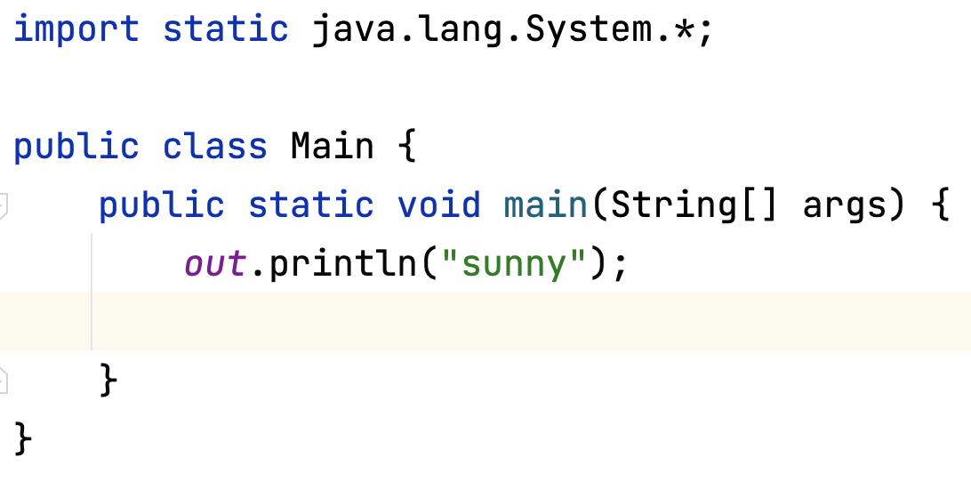
.
.

Slide 120
Protected
The protected access modifier is accessible within package and outside the package but through inheritance only.
The protected access modifier can be applied on the data member, method and constructor. It can't be applied on the class.
It provides more accessibility than the default modifer.

Slide 121
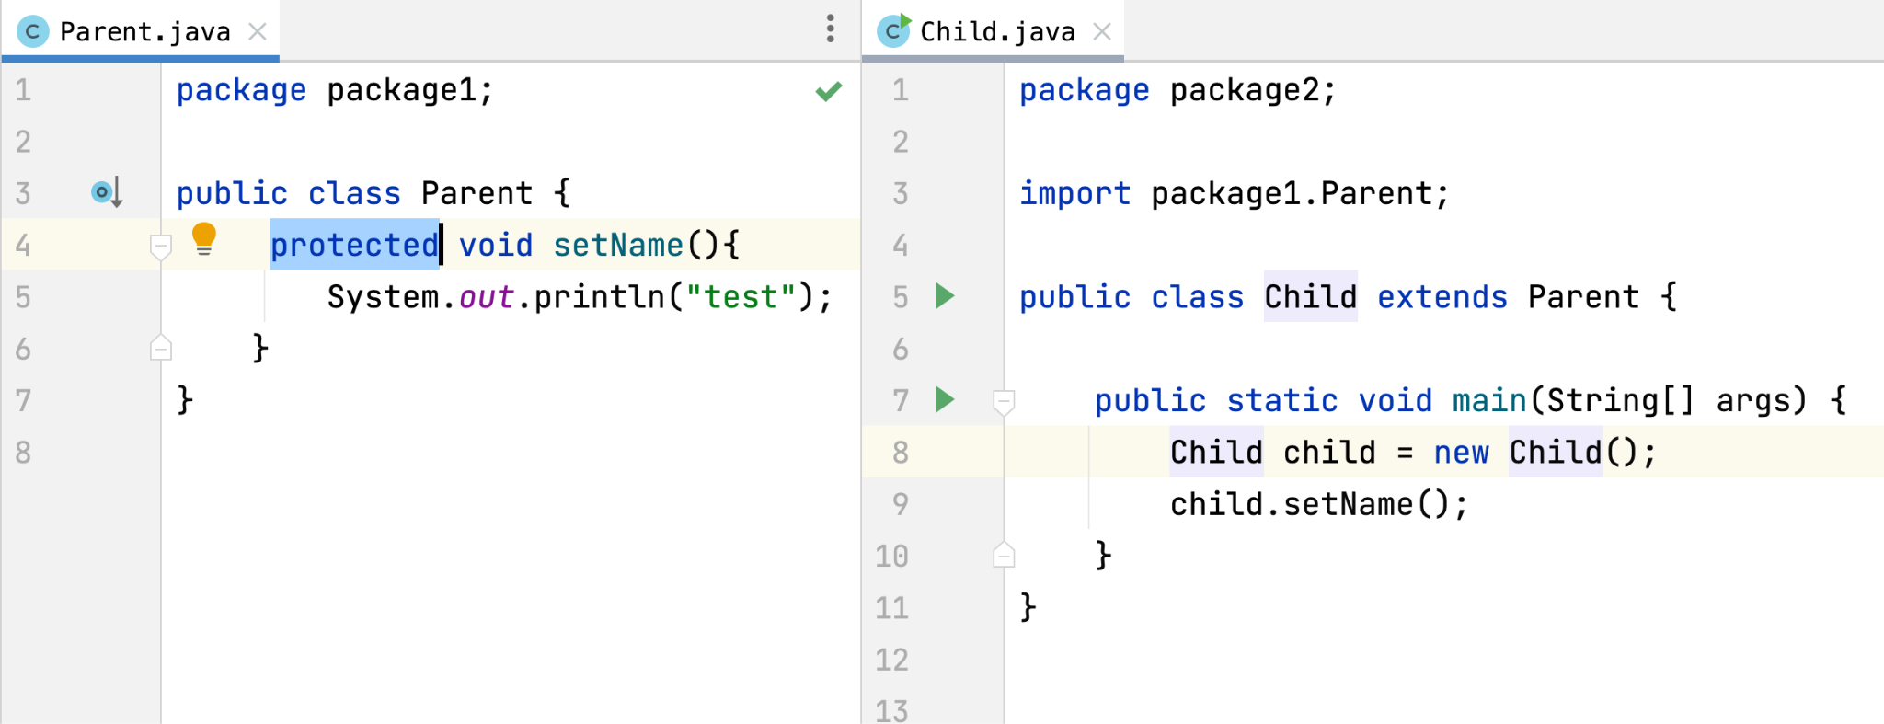
Example
.

Slide 122
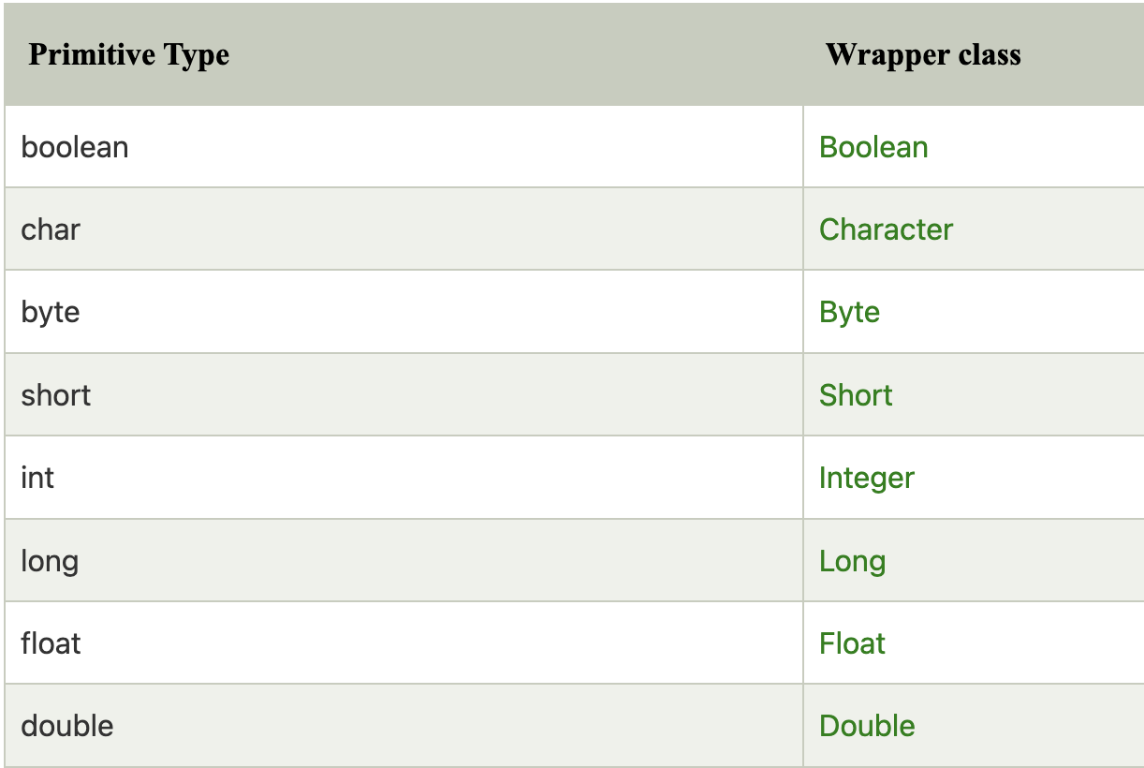
Wrapper Classes
The wrapper class in Java provides the mechanism to convert primitive into object and object into primitive.
Since J2SE 5.0, autoboxing and unboxing feature convert primitives into objects and objects into primitives automatically. The automatic conversion of primitive into an object is known as autoboxing and vice-versa unboxing.

Slide 123
Type Casting
Type casting is when you assign a value of one primitive data type to another type.
In Java, there are two types of casting:
Widening Casting (automatically) - converting a smaller type to a larger type size byte -> short -> char -> int -> long -> float -> double
Narrowing Casting (manually) - converting a larger type to a smaller size type double -> float -> long -> int -> char -> short -> byte

Slide 124
Exception Handling
An exception is an abnormal condition that arises in a code sequence at run time. In other words, an exception is a run-time error.
Java exception handling is managed via five keywords: try, catch, throw, throws, and finally

Slide 125
Errors
Errors represent irrecoverable conditions such as Java virtual machine (JVM) running out of memory, memory leaks, stack overflow errors, library incompatibility, infinite recursion, etc. Errors are usually beyond the control of the programmer, and we should not try to handle errors.

Slide 126
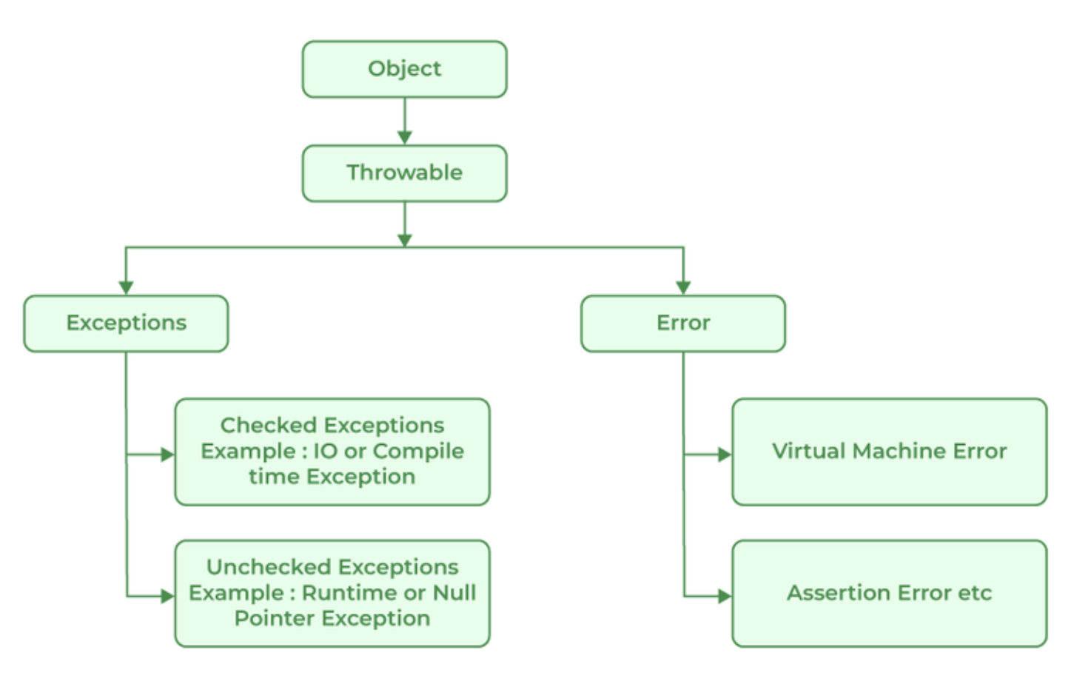

Slide 127
Types of Exception
There are mainly two types of exceptions: checked and unchecked.
1) Checked Exception
The classes that directly inherit the Throwable class except RuntimeException and Error are known as checked exceptions. For example, IOException, SQLException, etc. Checked exceptions are checked at compile-time.
2) Unchecked Exception
The classes that inherit the RuntimeException are known as unchecked exceptions. For example, ArithmeticException, NullPointerException, ArrayIndexOutOfBoundsException, etc. Unchecked exceptions are not checked at compile-time, but they are checked at runtime.

Slide 128
Try and catch
The try statement allows you to define a block of code to be tested for errors while it is being executed.
The catch statement allows you to define a block of code to be executed, if an error occurs in the try block.
The try and catch keywords come in pairs:

Slide 129
The try block contains the block of code where you (the programmer) believe an exception might occur e.g., the user enters 0 as an input for a divide operation, which might result in an ArithmeticException. To prevent the system from breaking, those exceptions are handled in the catch block.

Slide 130
try {
// Block of code to try
}
catch(Exception e) {
// Block of code to handle errors
}

Slide 131
NullPointerException
ArrayIndexOutOfBoundsException
FileNotFoundException
IOException
NumberFormatException
ClassCastException

Slide 132
ArithmeticException
IllegalArgumentException
RuntimeException
InterruptedException
ConcurrentModificationException

Slide 133
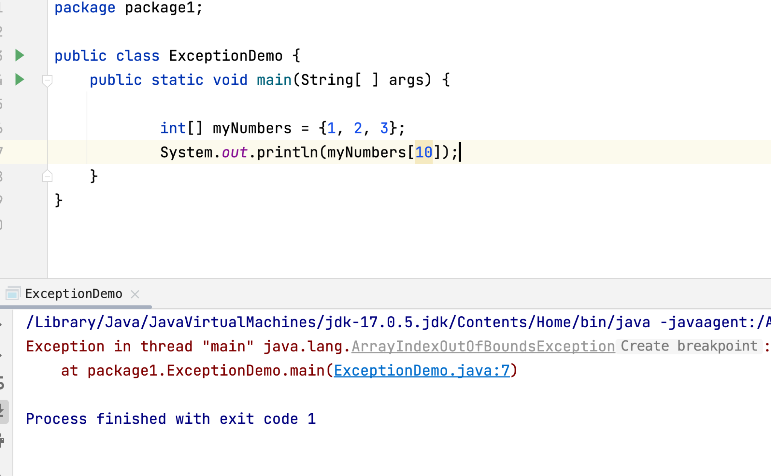
Without try-catch
.

Slide 134
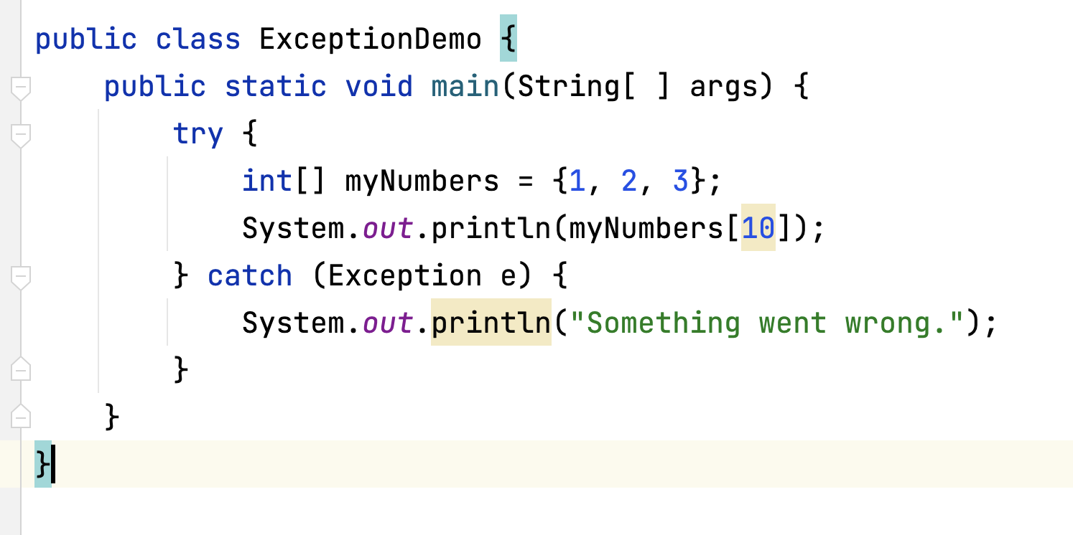
With try-catch
.

Slide 135
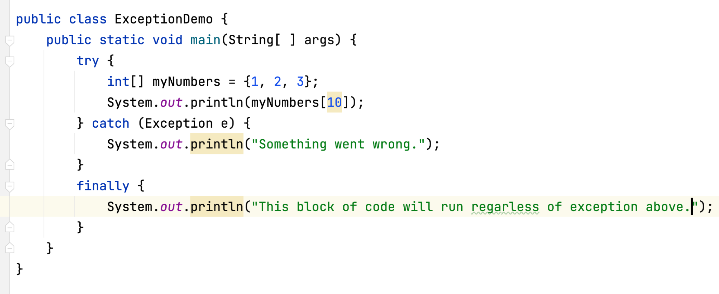
Finally?
The finally statement lets you execute code, after try...catch, regardless of the result:

Slide 136
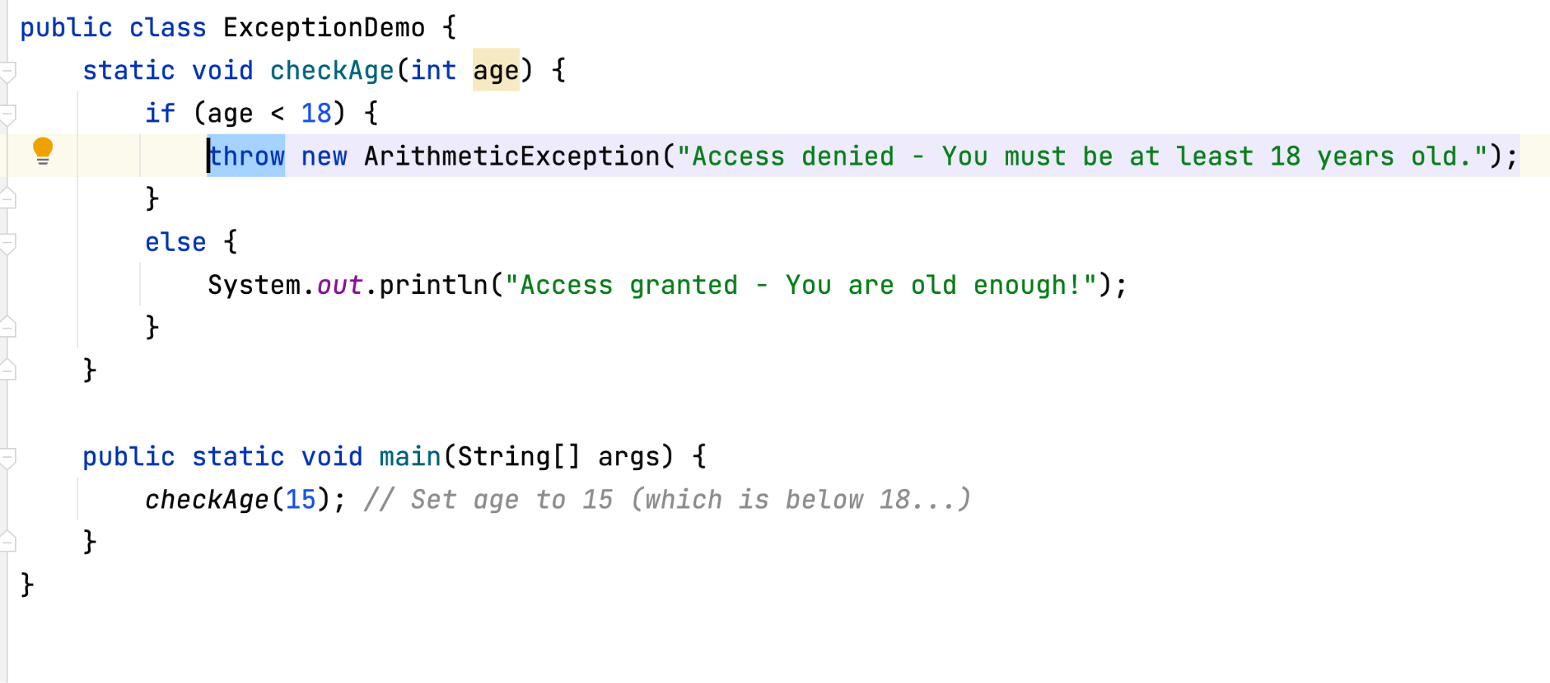
Throw
.

Slide 137
Throws
The Java throws keyword is used to declare an exception. It gives an information to the programmer that there may occur an exception. So, it is better for the programmer to provide the exception handling code so that the normal flow of the program can be maintained.
public void someMethod() throws SomeExceptionType {
// Method code that might throw SomeExceptionType
}

Slide 138
Important interview question
Throw vs Throws?
Final vs Finally vs Finalize?
String vs StringBuilder vs StringBuffer?

Slide 139
File Handling
Java has several methods for creating, reading, updating, and deleting files.
import java.io.File; // Import the File class
File myObj = new File("filename.txt"); // Specify the filename

Slide 140

File methods..

Slide 141

Create a file..
.

Slide 142

Write to file.

Slide 143

Read from file

Slide 144
Enums
An enum is a special "class" that represents a group of constants (unchangeable variables, like final variables).
To create an enum, use the enum keyword (instead of class or interface), and separate the constants with a comma. Note that they should be in uppercase letters:
enum Size {
SMALL,
MEDIUM,
LARGE
}

Slide 145
Generics
Generics means parameterized types. The idea is to allow type (Integer, String, … etc., and user-defined types) to be a parameter to methods, classes, and interfaces. Using Generics, it is possible to create classes that work with different data types. An entity such as class, interface, or method that operates on a parameterized type is a generic entity.

Slide 146
Generic Class
To create objects of a generic class, we use the following syntax.
// To create an instance of generic class
BaseType <Type> obj = new BaseType <Type>()
Note: In Parameter type we can not use primitives like ‘int’,’char’ or ‘double’.
Advantage of Java Generics
Type-safety
Type casting is not required
Compile-Time Checking

Slide 147
Immutable Class
The instance variable of the class is final i.e. we cannot change the value of it after creating an object.
The class is final so we cannot create the subclass.
There is no setter methods i.e. we have no option to change the value of the instance variable.
Examples: Wrapper classes (Integer, Boolean) and String

Slide 148

Collections
The Collection in Java is a framework that provides an architecture to store and manipulate the group of objects.

Slide 149
List interface
A List is an ordered Collection of elements which may contain duplicates. It is an interface that extends the Collection interface. Lists are further classified into the following:
ArrayList
LinkedList
Stack

Slide 150
ArrayList
ArrayList is the most widely used implementation of the List interface. Some of the salient features of an ArrayList are:
Elements are stored in the order of insertion.
It allows the storage of duplicate elements.
ArrayList also supports null elements.

Slide 151
Space and Time Complexity
https://www.freecodecamp.org/news/big-o-cheat-sheet-time-complexity-chart/

Slide 152
Internal implementation of ArrayList
An ArrayList stores data in a resizable array. Before Java 8, when an ArrayList was created, an array of default size ten was created internally. Now, when an ArrayList is created, an array of size zero is created. Only when the first element is inserted does the array size change to ten. This is called lazy initialization, and it saves a lot of memory.
Before adding an element in ArrayList, its capacity is checked. If the internal array is full, then a new array of size (n + n/2 +1) is created (e.g., if the capacity is ten, then a new array of size 16 will be created). The elements from the old array will be copied to the new array. This increases the capacity of an ArrayList, which is a time-consuming process.

Slide 153
Set Interface
A Set refers to a collection that cannot contain duplicate elements. It is mainly used to model the mathematical set abstraction. Set has its implementation in various classes such as HashSet, TreeSet and LinkedHashSet. Set are further classified into the following:
HashSet
LinkedHashSet
TreeSet

Slide 154

Queue Interface

Slide 155

Map Interface
In Java, Map Interface is present in java.util package represents a mapping between a key and a value.

Slide 156
HashMap
HashMap is a class in the java.utils package that implements the Map interface. It is used to store the key-value pair
Some of the features of HashMap are:
The keys should be unique.
HashMap allows only one null key.
The values can be null or duplicate.
The keys are stored in random order.

Slide 157
Additional Map Classes
ConcurrentHashMap - Interview
SynchronizedMap - Interview
IdentityHashMap

Slide 158

.
.

Slide 159
Collections class
The Collections class in Java is a part of the Java Collections Framework, which provides various utility methods for working with collections (lists, sets, maps, etc.) in a more efficient and convenient way. It contains static methods for performing common operations on collections, such as sorting, searching, and synchronization.
Java Collection class throws a NullPointerException if the collections or class objects provided to them are null.

Slide 160
Sorting: The Collections.sort() method allows you to sort a list of elements in natural order or using a custom comparator. This is especially helpful when dealing with lists of objects that need to be ordered.
Finding Minimum and Maximum: The Collections.min() and Collections.max() methods provide ways to find the minimum and maximum elements from a collection, respectively.
Frequency of Elements: The Collections.frequency() method counts the occurrences of a specific element in a collection.
Creating Immutable Collections: The Collections.unmodifiableCollection(), Collections.unmodifiableList(), etc., methods generate unmodifiable views of collections, which can be useful to ensure data integrity and avoid unintended modifications.

Slide 161
Arrays class
Arrays is a class in the java.utils package that contains various methods for manipulating arrays (such as sorting and searching). This class also contains a static factory that allows arrays to be seen as a list. The methods in this class throw a NullPointerException if the specified array reference is null

Slide 162

Converting an Array into a List

Slide 163
Comparable Interface
It contains a method called 1. compareTo(T o)
-1 if tobj1 is less than obj2
1 if obj1 is greater than obj2
0 if obj1 is equal to obj2

Slide 164
Comparator Interface
compare(T o1, T o2)

Slide 165
Java 8
Lambda expressions
Functional interfaces
Streams api
Data and time api

Slide 166
What is a lambda expression?
Java is an object-oriented language. By introducing lambdas in Java 8, the authors of Java tried to add elements of functional programming in Java. Now you might be wondering what the difference between object-oriented programming and functional programming is?
In object-oriented programming, objects and classes are the main entities. If we create a function then it should exist within a class. A function has no meaning outside the scope of the class object.
In functional programming, functions can exist outside the scope of an object. We can assign them to a reference variable and we can also pass them to other methods as a parameter.
A lambda expression is just an anonymous function, i.e., a function with no name and that is not bound to an identifier. We can pass it to other methods as parameters, therefore, using the power of functional programming in Java.

Slide 167
Lambda
Lambda is equivalent to a function without a name
Also referred as Anonymous functions.
Lambdas are not tied to any class like a regular method
Lambdas can also be assigned to variable and passed around.
Mainly used to implement Functional Interfaces.

Slide 168

Syntax

Slide 169

Functional Interface
An interface with only one abstract method is called functional interface.

Slide 170
Exactly One Abstract Method: A functional interface must have exactly one abstract method that defines its functional behavior
Default Methods: Default methods are methods in an interface that have a default implementation
Static Methods: Similarly, static methods can also be included in a functional interface without changing its functional characteristics. Static methods in interfaces are not inherited by implementing classes or interfaces.

Slide 171
Problem statement
Design and implement a functional interface in Java that encapsulates the behavior of a 'Calculator' concept.
This functional interface should define a method for performing arithmetic operations (such as addition, subtraction, multiplication, and division) on two input numbers.
Create concrete implementations of this functional interface for each arithmetic operation and demonstrate their usage in a sample application."

Slide 172
Built-in Functional Interfaces
Supplier
Consumer -> Bi-Consumer
Predicate -> Bi-Predicate
Function -> Bi-Function, Unary Operator, Binary Operator
Runnable –> This interface only contains the run() method.
Comparable –> This interface only contains the compareTo() method.
ActionListener –> This interface only contains the actionPerformed() method.
Callable –> This interface only contains the call() method.

Slide 173
Consumer
Consumers are functional interfaces that take in a parameter and do not produce anything.
@FunctionalInterface
public interface Consumer<T> {
void accept(T t);
}

Slide 174
Predicate
The Predicate<T> interface has an abstract method boolean test(T t). Basically, a predicate is a function that evaluates the given input and returns true or false.
@FunctionalInterface
public interface Predicate<T> {
boolean test(T t);
}

Slide 175
Supplier
Supplier is an interface that does not take in any argument but produces a value when the get() function is invoked. Suppliers are useful when we don’t need to supply any value and obtain a result at the same time.
@FunctionalInterface
public interface Supplier<T> {
T get();
}

Slide 176
Function
Function is a category of functional interfaces that takes an object of type T and returns an object of type R.
Until now, the functional interfaces that we’ve discussed have either not taken any argument(Supplier), not returned any value(Consumer), or returned only a boolean(Predicate).
Function interfaces are very useful as we can specify the type of input and output.

Slide 177
@FunctionalInterface
public interface Function<T, R> {
R apply(T t);
}

Slide 178
write a predicate to test if number if even?
2. write a predicate to test if number if odd?
3. write a predicate to test if give string is empty or not?
4. write a predicate to check if the number is positive or negative?

Slide 179
Streams api
A Stream in Java can be defined as a sequence of elements from a source that supports aggregate operations on them. The source here refers to collections or arrays that provide data to a stream.
A few important points about streams are:
A stream is not a data structure itself. It is a bunch of operations applied to a source. The source can be collections, arrays or I/O channels.
Streams don’t change the original data structure.
There can be zero or more intermediate operations that transform a stream into another stream.
Each intermediate operation is lazily executed
Terminal operations produce the result of the stream.

Slide 180


Slide 181
Streams Creation
Streams can be created from different element sources, e.g., a collection or an array with the help of stream() and of() methods. Below are the different ways to create a stream.
a) Stream.of(v1, v2, v3….)
b) List.stream()

Slide 182
Stream operations
Intermediate operations
These methods do not produce any results. They usually accept functional interfaces as parameters and always return a new stream. Some examples of intermediate operations are filter(), map(), etc.

Slide 183
Terminal operations
These methods produce some results, e.g., count(), toArray(..), and collect(..).
The streams operations can be further classified as:
filtering
slicing
mapping
matching and finding
reduction
collect
This was the basic introduction to streams. In the next few lessons, we will explore each of these operations. We will also look at how these methods are combined together to process collections.

Slide 184
Filtering Operations in Stream
filter() method
filter() method with custom object
filter() chaining

Slide 185
Mapping Operations in Stream
map()
mapToInt()
flapMap()

Slide 186
Method References
Reference to methods

Slide 187
Optional in Java 8
What is an Optional?
Java 8 has introduced a new class Optional<T> in the java.util package.
The Optional<T> is a wrapper class that stores an object of type T. The object may or may not be present in the optional.
According to Oracle, “Java 8 Optional works as a container type for the value which is probably absent or null. Java Optional is a final class present in the java.util package.”

Slide 188
Slicing Operations in Stream
1. distinct()
2. limit()
3) skip()

Slide 189
Matching Operations in Stream
anyMatch()
allMatch()
noneMatch()

Slide 190
Collectors: Collection Operations
Collectors to list
To map
To set

Slide 191
Finding Operations in Stream
findFirst() and findAny().

Slide 192
Mutable Reduction Through reduce()
Reduce ?

Slide 193
Create a BankAccount class with the following attributes:
accountNumber (unique identifier for the account)
balance (current balance in the account)
Implement the following methods in the BankAccount class:
deposit(double amount): Increases the account balance by the given amount.
withdraw(double amount): Decreases the account balance by the given amount. If the withdrawal amount is greater than the account balance, throw an InsufficientBalanceException.
getBalance(): Returns the current account balance.
Create a custom checked exception called InsufficientBalanceException that is thrown when a withdrawal is attempted with insufficient funds.
Write a BankTransactionApp class that demonstrates the usage of the BankAccount class:
Create a new BankAccount instance.
Perform a few deposits and withdrawals, handling the InsufficientBalanceException appropriately.
Display the account balance after each transaction.
Remember to handle exceptions gracefully using try-catch blocks and to provide informative error messages to the user.

Slide 194
Multithreading
Multithreading in Java is a process of executing multiple threads simultaneously.
A thread is a lightweight sub-process, the smallest unit of processing. Multiprocessing and multithreading, both are used to achieve multitasking.
However, we use multithreading than multiprocessing because threads use a shared memory area. They don't allocate separate memory area so saves memory, and context-switching between the threads takes less time than process.

Slide 195
Terms..
Program
A program is a set of instructions and associated data that resides on the disk and is loaded by the operating system to perform some task. An executable file or a python script file are examples of programs. In order to run a program, the operating system's kernel is first asked to create a new process, which is an environment in which a program executes.
Process
A process is a program in execution. A process is an execution environment that consists of instructions, user-data, and system-data segments, as well as lots of other resources such as CPU, memory, address-space, disk and network I/O acquired at runtime. A program can have several copies of it running at the same time but a process necessarily belongs to only one program.

Slide 196
Thread
Thread is the smallest unit of execution in a process. A thread simply executes instructions serially. A process can have multiple threads running as part of it. Usually, there would be some state associated with the process that is shared among all the threads and in turn each thread would have some state private to itself. The globally shared state amongst the threads of a process is visible and accessible to all the threads, and special attention needs to be paid when any thread tries to read or write to this global shared state. There are several constructs offered by various programming languages to guard and discipline the access to this global state, which we will go into further detail in upcoming lessons.

Slide 197
Concurrency
A concurrent program is one that can be decomposed into constituent parts and each part can be executed out of order or in partial order without affecting the final outcome. A system capable of running several distinct programs or more than one independent unit of the same program in overlapping time intervals is called a concurrent system. The execution of two programs or units of the same program may not happen simultaneously
A concurrent system can have two programs in progress at the same time where progress doesn't imply execution. One program can be suspended while the other executes. Both programs are able to make progress as their execution is interleaved. In concurrent systems, the goal is to maximize throughput and minimize latency. For example, a browser running on a single core machine has to be responsive to user clicks but also be able to render HTML on screen as quickly as possible. Concurrent systems achieve lower latency and higher throughput when programs running on the system require frequent network or disk I/O.

Slide 198
Parallelism
A parallel system is one which necessarily has the ability to execute multiple programs at the same time. Usually, this capability is aided by hardware in the form of multicore processors on individual machines or as computing clusters where several machines are hooked up to solve independent pieces of a problem simultaneously. Remember an individual problem has to be concurrent in nature, that is portions of it can be worked on independently without affecting the final outcome before it can be executed in parallel.
In parallel systems the emphasis is on increasing throughput and optimizing usage of hardware resources.

Slide 199


Slide 200
Race Condition
Race conditions happen when threads run through critical sections without thread synchronization. The threads "race" through the critical section to write or read shared resources and depending on the order in which threads finish the "race", the program output changes. In a race condition, threads access shared resources or program variables that might be worked on by other threads at the same time causing the application data to be inconsistent.

Slide 201
DeadLock
Deadlocks occur when two or more threads aren't able to make any progress because the resource required by the first thread is held by the second and the resource required by the second thread is held by the first.

Slide 202
Advantages of Java Multithreading
1) It doesn't block the user because threads are independent and you can perform multiple operations at the same time.
2) You can perform many operations together, so it saves time.
3) Threads are independent, so it doesn't affect other threads if an exception occurs in a single thread.

Slide 203
Thready Safety & Synchronized
A class and its public APIs are labelled as thread safe if multiple threads can consume the exposed APIs without causing race conditions or state corruption for the class

Slide 204
Synchronized
Java’s most fundamental construct for thread synchronization is the synchronized keyword. It can be used to restrict access to critical sections one thread at a time.
Each object in Java has an entity associated with it called the "monitor lock" or just monitor. Think of it as an exclusive lock. Once a thread gets hold of the monitor of an object, it has exclusive access to all the methods marked as synchronized. No other thread will be allowed to invoke a method on the object that is marked as synchronized and will block, till the first thread releases the monitor which is equivalent of the first thread exiting the synchronized method.

Slide 205

Thread states

Slide 206
How to create a thread in Java
There are two ways to create a thread:
By extending Thread class
By implementing Runnable interface.
sleep() method ?
Synchronization
Deadlock

Slide 207
Runnable Interface
When we create a thread, we need to provide the created thread code to execute, or in other words we need to tell the thread what task to execute. The code can be provided as an object of a class that implements the Runnable interface. As the name implies, the interface forces the implementing class to provide a run method which in turn is invoked by the thread when it starts.

Slide 208

Runnable
.

Slide 209

Extending Thread Class

Slide 210

Sleeping Threads

